Slide 1
PERiLS Field Data Archive
Scot Loehrer
NCAR/EOL
PERiLS Science Meeting
Memphis, TN
16 November 2023

Slide 2
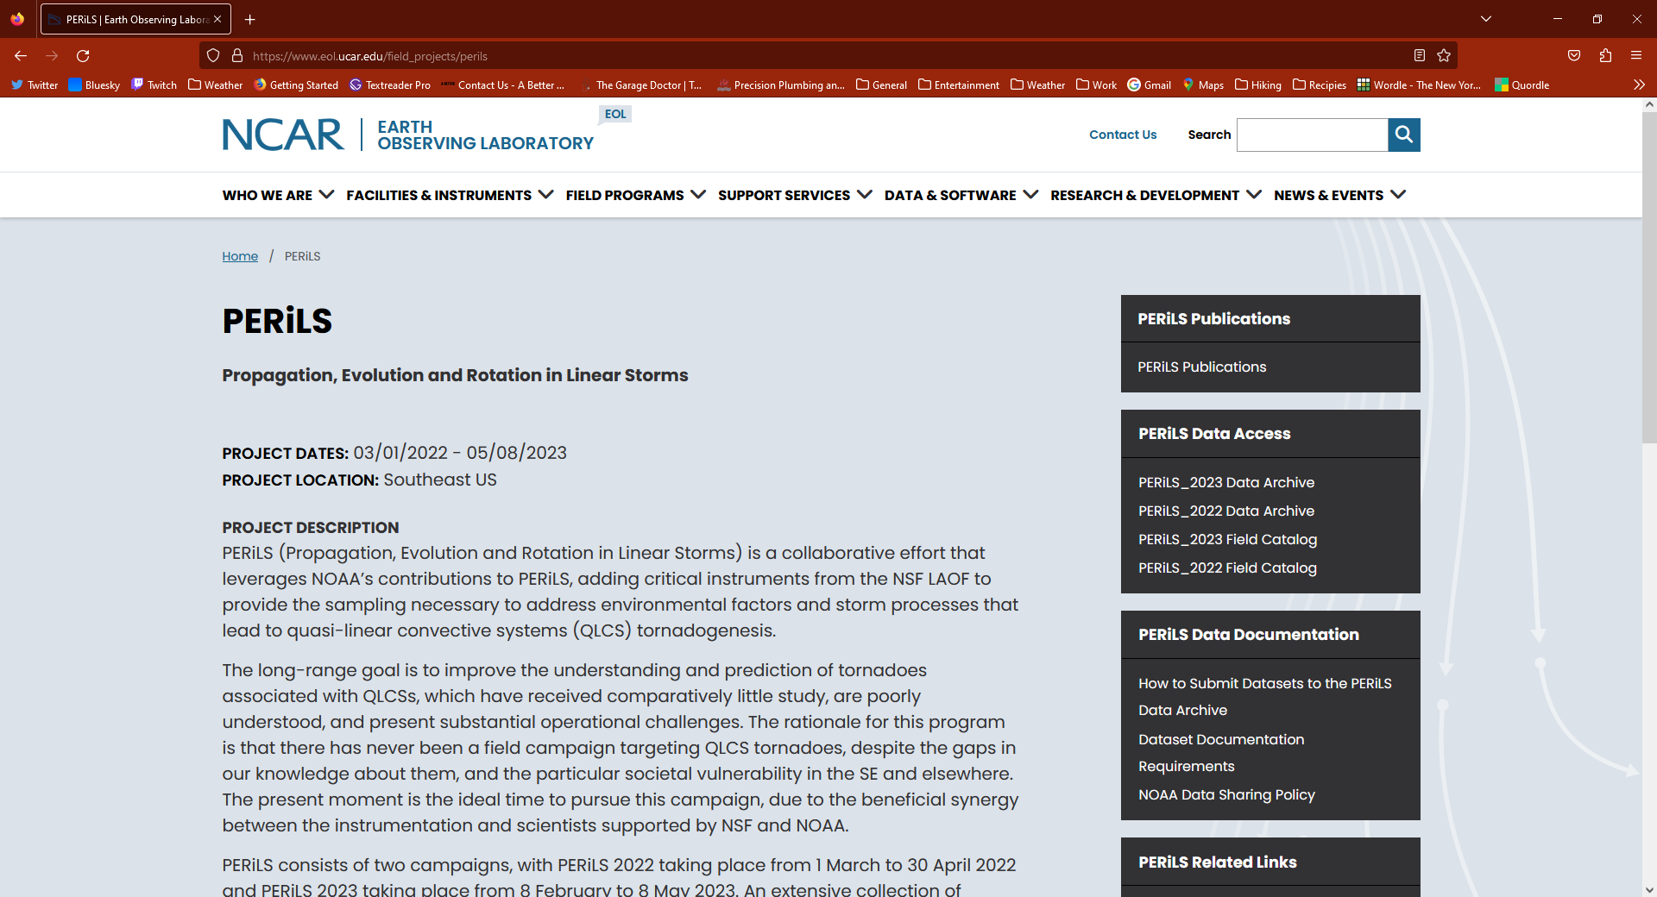
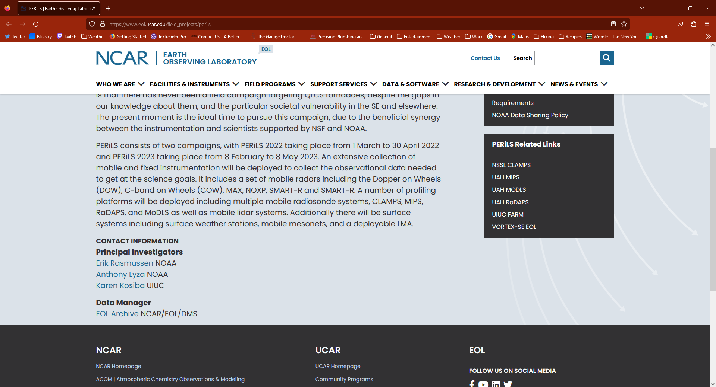
NCAR/EOL PERiLS Web Site - https://www.eol.ucar.edu/field_projects/perils
EOL recently updated to the latest version of Drupal
Project Description
Data Archive Access
Field Catalog Access
Dataset Submission Instructions
Dataset Documentation Requirements
Publications
Related Web Pages

Slide 3
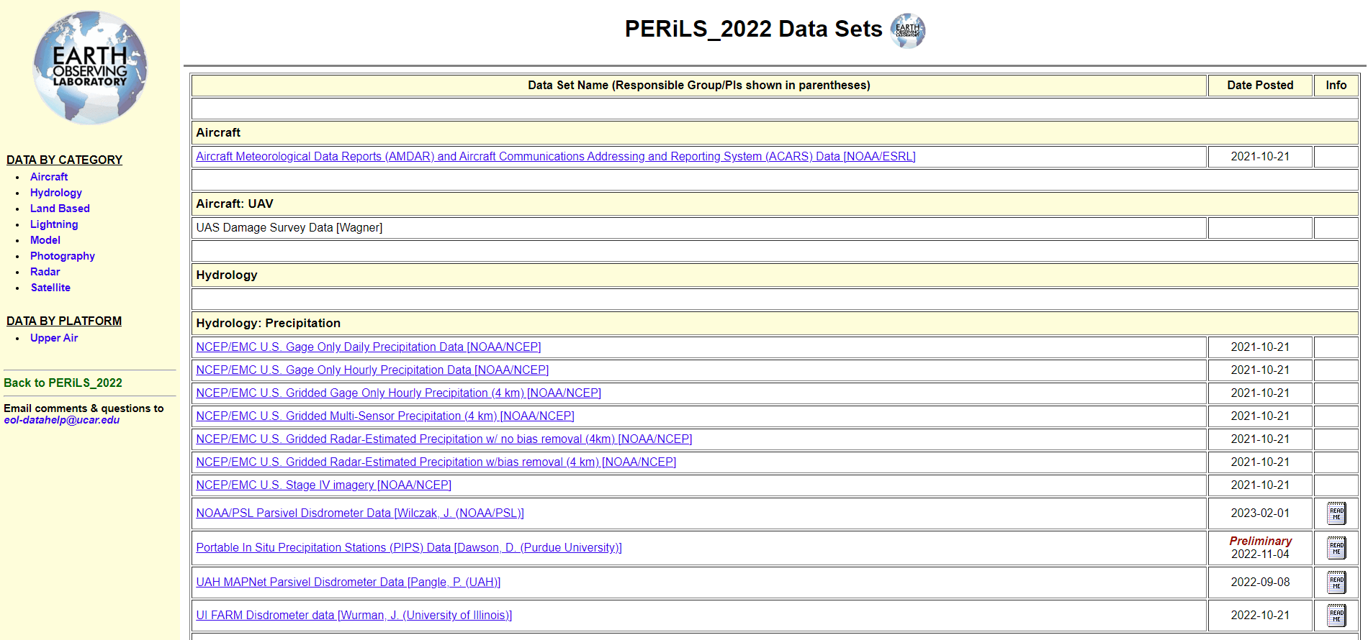
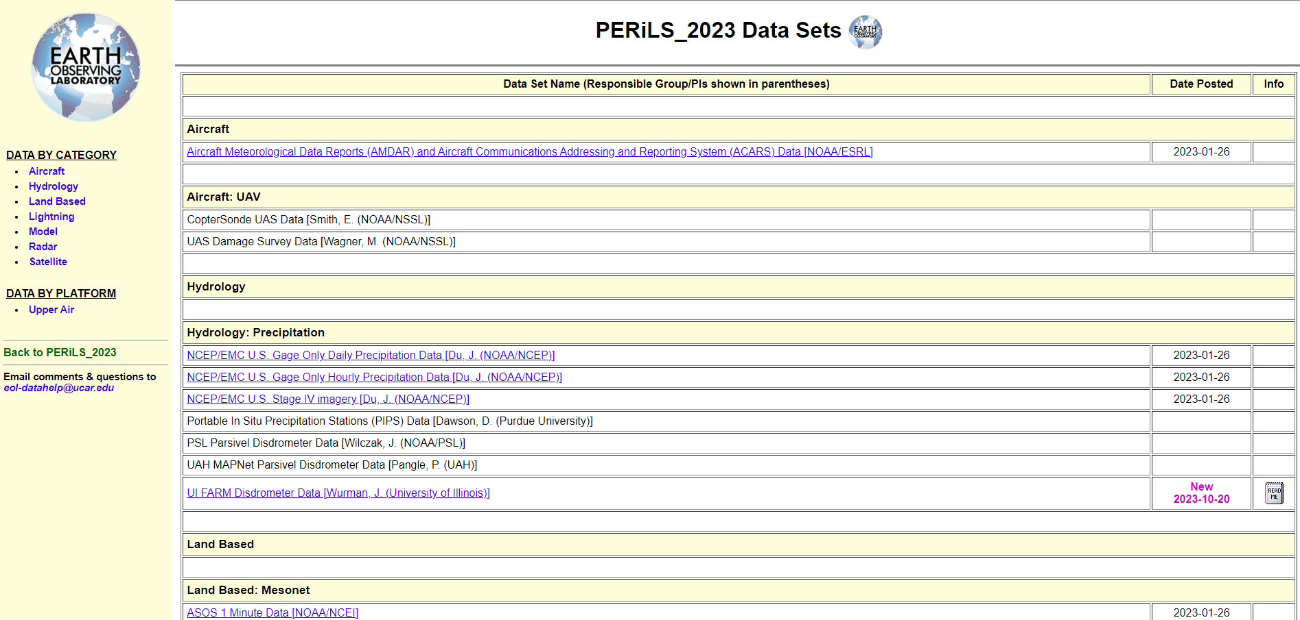
NCAR/EOL PERiLS Field Data Archive
Lists all PERiLS 2022 and 2023 datasets whether housed in the NCAR/EOL FDA or elsewhere
Includes research as well as supporting operational datasets
Datasets organized by Categories
If a new version of a dataset is released, users are notified via email.
Access credentials for PERiLS datasets within the FDA:
  User: perils
  Password: qcls-t0rn
A new FDA interface is coming soonTM
https://data.eol.ucar.edu/master_lists/generated/perils_2022
https://data.eol.ucar.edu/master_lists/generated/perils_2023

Slide 4
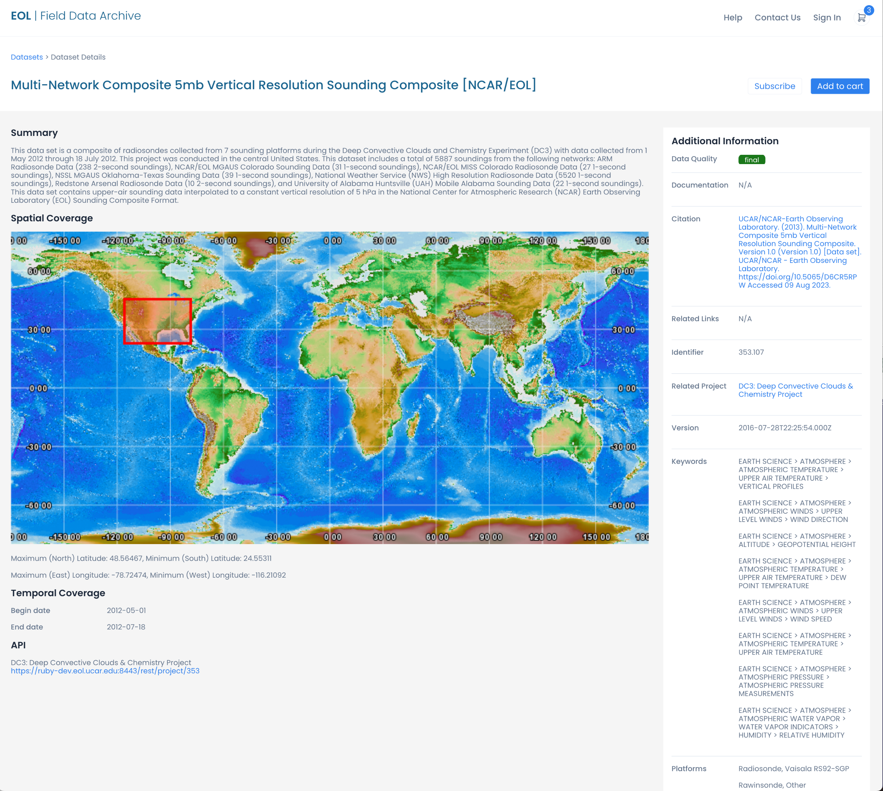
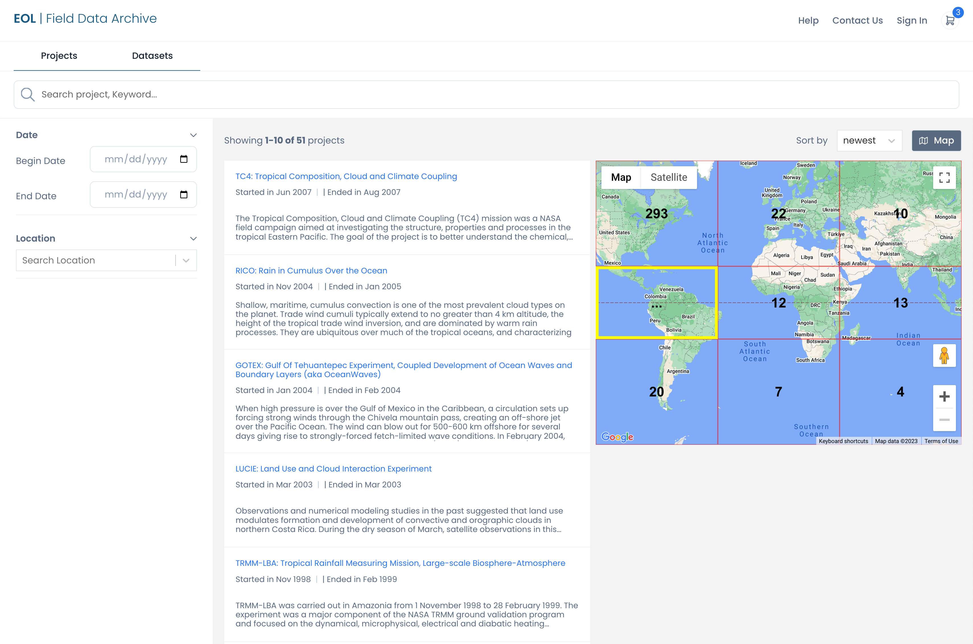
NCAR/EOL Field Data Archive Interface Updates
Updated look and feel
Substantially improved search capabilities (platforms, instruments, science keywords, map search, etc)
Dataset pages will include listing of publications that referenced the dataset DOI

Slide 5
NCAR/EOL PERiLS Data Archive Research Datasets
2022 Archive nearly complete, just a few of outstanding datasets. Final SMART-R data was just submitted and will be available soon.
2023 Archive already contains:
  CLAMPS2 Doppler Lidar Vertical Stare and VAD
  CLAMPS2 MWR TROPoe Retreivals
  FARM COW and DOWs
  FARM Disdrometers
  FARM Mobile Mesonet
  FARM PODs
  NOAA PSL ASSIST Radiances
  NOAA PSL Ceilometers
  NOAA PSL MWR Brightness Temperatures and Surface Met
  NOAA PSL RWP, RASS and Surface Met
  NOXP Radar
  NSSL Deployable LMA
  NSSL Mobile Mesonet
  SMART-R Preliminary Data (just submitted will be available soon)
  TTU StickNet
https://data.eol.ucar.edu/master_lists/generated/perils_2022
https://data.eol.ucar.edu/master_lists/generated/perils_2023

Slide 6
NCAR/EOL PERiLS Data Archive Supporting Operational Datasets
MADIS Mesonet Data
ASOS Data (1 and 5 minute resolution)
Global METAR observations (in NetCDF, ASCII, and GEMPAK formats)
Full resolution (1 second) NWS radiosonde data (BUFR format)
Mandatory/significant level NWS radiosonde data (GEMPAK format)
NLDN and NAPLN Lightning Data (password protected separately from PERiLS datasets, PI access only)
MRMS and GOES Data (via links to AWS)
NCEP Gage and Gridded Precipitation Data
ACARS/AMDAR
https://data.eol.ucar.edu/master_lists/generated/perils_2022
https://data.eol.ucar.edu/master_lists/generated/perils_2023

Slide 7
Submitting Datasets to the PERiLS Field Data Archive
Datasets can be submitted to our PERiLS ftp site via linux command line or your favorite FTP client (e.g. FileZilla). The credentials are:
Server: ftp.eol.ucar.edu
User: anonymous
Directory: /pub/data/incoming/perils
A documentation file MUST be included with your submission. This is to help ensure the long-term useability of the data.
Datasets can be submitted via other methods (e.g. Globus, Dropbox, Google Drive, email (if small), etc). If you need to use another method please send me an email (loehrer@ucar.edu) when ready to submit.
Whatever method, once your submission is completed, send me an email (loehrer@ucar.edu) so that it can be moved into the FDA.
If you develop an updated version of a dataset you’ve already submitted to the archive, you should send the revised dataset along with an updated documentation file that includes information on what has changed in the new version. We send an email to users who ordered the previous version to let them know that a new version is available.
Unless otherwise requested DOIs are issued for datasets in their final (publication-ready) form.
These instructions are also available here: https://www.eol.ucar.edu/node/31199

Slide 8
Dataset Documentation Requirement
NCAR/EOL requires the inclusion of a documentation file with all datasets submitted to the archive.
This is to help ensure the long-term usability of datasets included in the Archive.
You should try to include as much information in the documentation file itself (or include them as separate PDF file(s) rather than pointing to websites. Websites tend to move or disappear over time and unless they were specific to a campaign their contents tend to change to reflect current instrumentation rather than the instrumentation at the time of the campaign.
Some of the information that should be included:
Authors and contact information (if you have an ORCID ID please include it)
Instrumentation descriptions including specifications
Data collection and processing procedures including QA/QC
Data file description including file naming conventions, format description, parameters and units, description and definition of any codes or flags
An assessment of the data including any disclaimers, instrument problems, quality issues
Software compatibility
References
A sample layout with the expected contents: https://www.eol.ucar.edu/node/4871

Slide 9
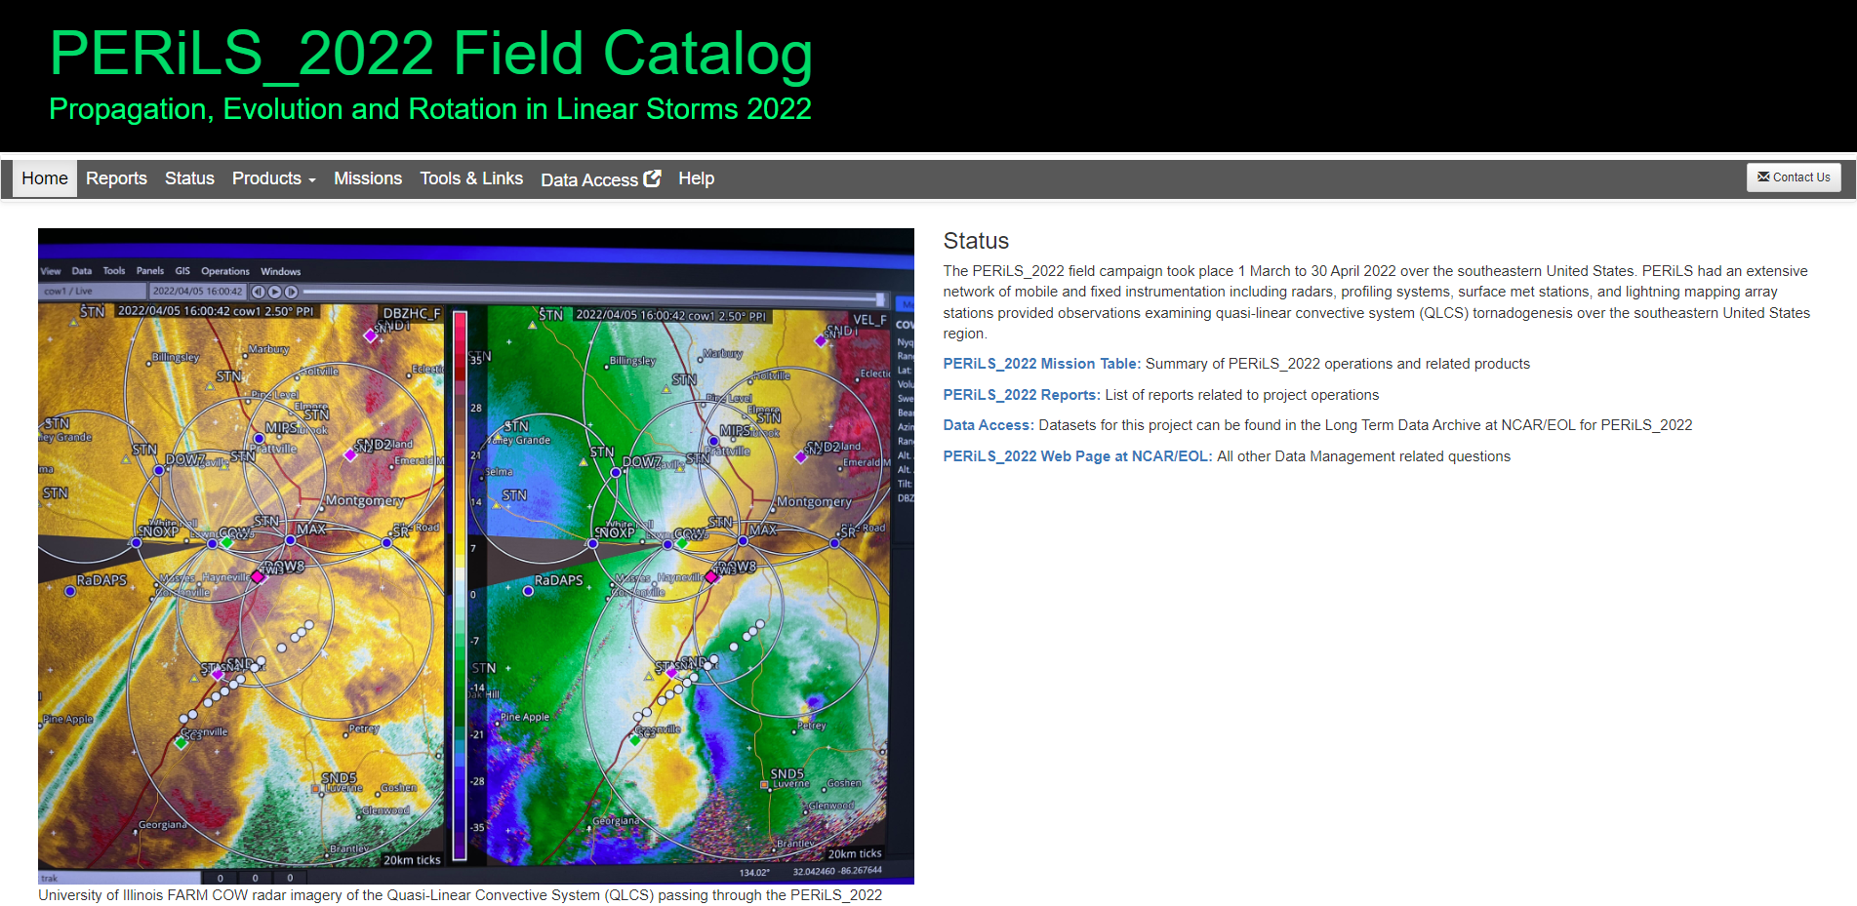
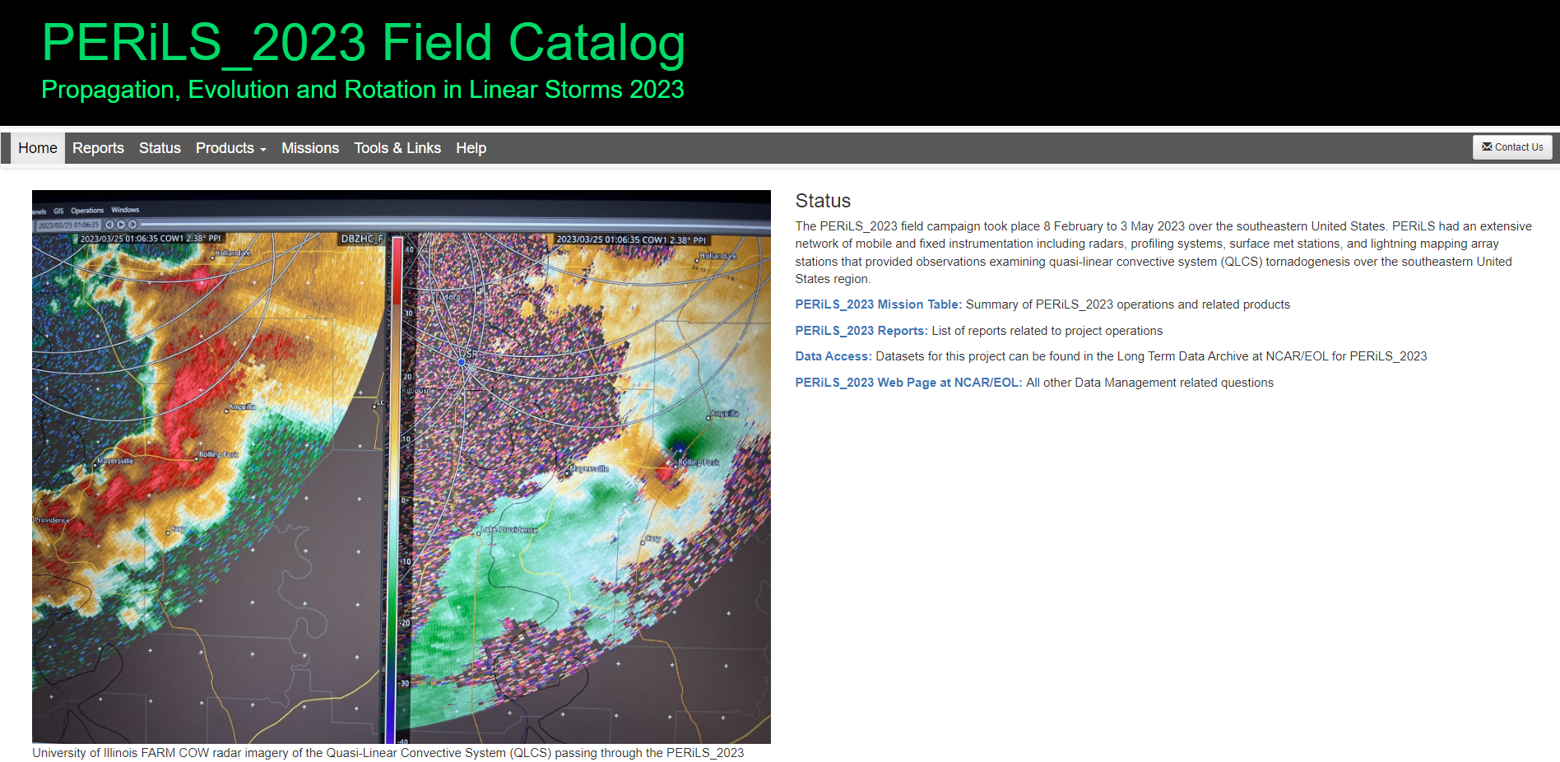
PERiLS Field Catalogs
The PERiLS Field Catalogs are part of the EOL FDA and remain available. They contain the full compliment of reports and imagery gathered during the campaigns. Note that all imagery is based on preliminary real time data. The Missions tabs contain summaries of the IOPs with links to the relevant reports and imagery.
The PERiLS_2022 and PERiLS_2023 Field Catalogs contain a total of ~4 million products and 1.13TB of disk space.
PERiLS_2022 Field Catalog - http://catalog.eol.ucar.edu/perils_2022
PERiLS_2023 Field Catalog - http://catalog.eol.ucar.edu/perils_2023

Slide 10
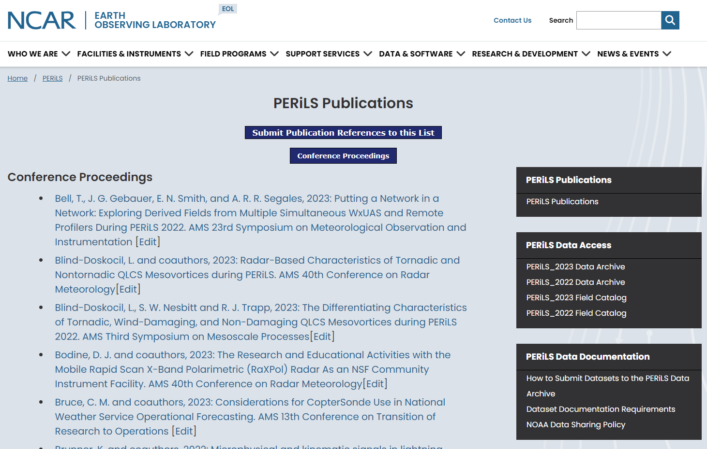
PERiLS Publications
Will contain links to PERiLS publications including journal articles, theses, conference proceedings, and reports.
Updated via occasional publication searches and if you would like to make sure your publications are included there is a submission form linked at the top of the page.
https://www.eol.ucar.edu/node/17229/publications

Slide 11
Thank you!
Please submit your datasets when they are ready for archival.
loehrer@ucar.edu

