Slide 1
PERiLS Year 2 ULM Doppler Wind LiDAR (DWL) + Sounding Data Update
Todd Murphy
University of Louisiana Monroe
PERiLS Science Meeting
11/16/23

Slide 2
Halo Photonics Streamline XR DWL
Instrument Info
18-m range gate spacing; Doppler bandwidth ± 19 m s^{–1}
First useable gate near 40-m AGL; Z_{MAX} depends on aerosol load, cloud base height, and precipitation.
DWL provides near instantaneous observations of the wind field
Operation strategy
Fixed location for IOP duration beginning 4-hours before T-0; coordinated with other profiler PIs
8-pt az VAD scans at 70° el every 5-min with continuous vertical stares in between
Care taken to ensure DWL was level and correct heading recorded in operating software
QC underway
Final datasets will be netCDF (*.stare.nc and *.VAD.nc)
All files will include epoch time, hours (since 00 UTC on day), lat, lon, alt, SNR, height (AGL above DWL)
Stare files will include w (m s^{–1}; vertical velocity) & attenuated backscatter (m^{–1} sr^{–1})
VAD files will include u, v, w (as retrieved from VAD technique), horizontal wind speed, horizontal wind direction, RMS (m s^{–1}; root mean square error of derived radial velocity compared to observed radial velocity) & R² (coefficient of determination comparing derived radial velocity to observed radial velocity; gives measure of wind field homogeneity)

Slide 3
iMet-4-AB 403 MHz sondes
Operation strategy
60-90 min radiosonde launches at fixed DWL location coordinated with other profiling teams typically beginning 4 hours prior to T-0
Launch frequency typically increased as convection approached but launches became less coordinated between teams
Balloons filled to target median ascent rates 3-5 m s^{–1}
QC complete; need to upload data
Similar to year 1 process
Automatic processing of raw sonde data by iMetOS-II software; resampled to 5-s resolution
QC for inconsistent heights, temp/dew, and wind data. Data removed if balloon was descending.
3 CSV text files for each launch (primary format, SPC/SHARPPy format, and flight summary)
Primary format gives launch date/time, location, and elevation in header with: lat, lon, UTC time, height, pressure, temp, RH, dew, wind speed, wind direction, & ascent rate

Slide 4
iMet-4-AB 403 MHz sondes
iMet-4 sondes tend to exhibit a low RH bias relative to surrounding surface data in some instances.
This has been examined in detail; bias is not systematic, but for some sondes dew points were 2-4°C lower than known calibrated sensors
Low bias was always within the uncertainty (5%) of the iMet RH sensor
During QC sonde data compared to surrounding surface datasets. Only a few flights had large discrepancies in surface dew points. These were adjusted by increasing the RH (≤ 5%) to better align with surrounding datasets.

Slide 5
Summary
YEAR 1 | IOP1 | IOP2 | IOP3 | IOP4 | Total
DWL hours | 9 | 7.5 | 7 | 5.5 | 29
Soundings | 8 | 9 | 7 | 7 | 31
YEAR 2 | IOP1 | IOP2 | IOP3 | IOP4 | IOP5 | Total
DWL hours | 12.8 | 10 | 9.3 | 10.7 | 6.4 | 49.2
Soundings | 9 | 8 | 8 | 9 | 6 | 40
With the exception of IOP4, both sonde and DWL data (including VAD retrievals) are good to excellent quality.
IOP4 (TN Valley) exhibited persistent signal quality issues with the sondes and lower quality DWL data; VAD retrievals are of poorer quality compared to the other IOPs – needs to be fully investigated
iMet sondes have transmission issues when lightning is nearby
Only an issue for a handful of sondes in year 2

Slide 6
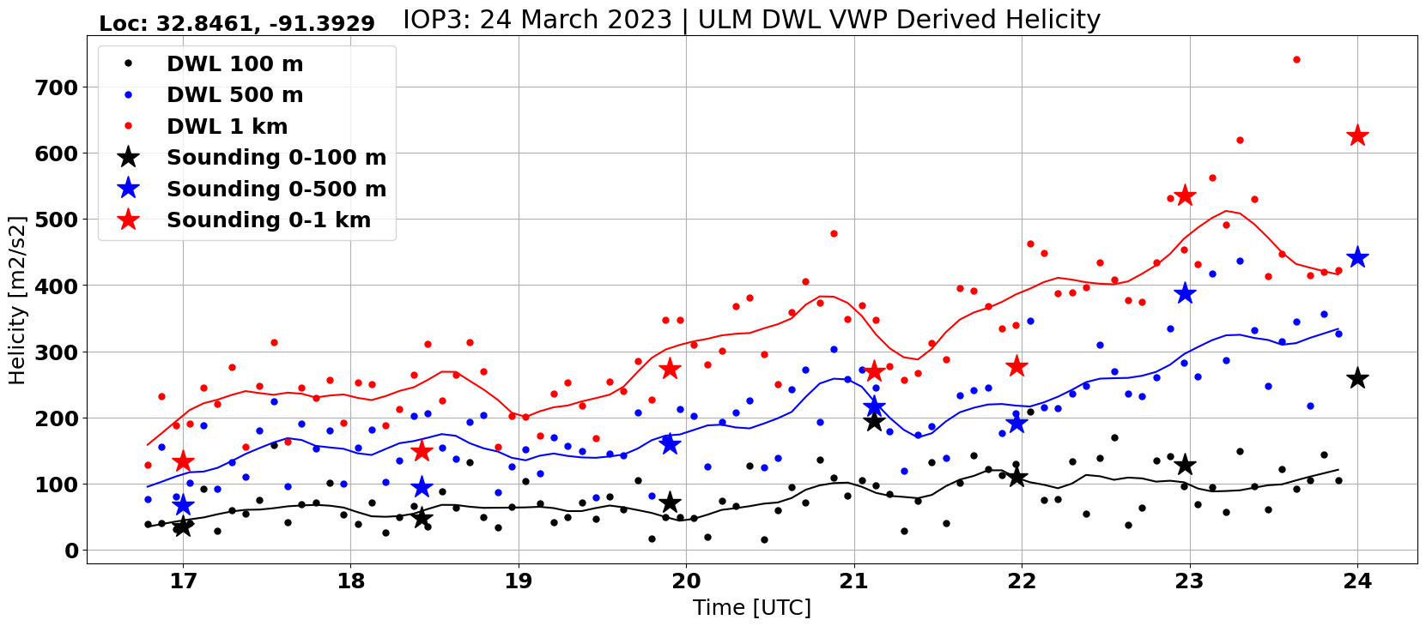
IOP3
Oak Grove, LA
DWL VAD Derived Helicity + Sonde Helicity

