Slide 1
PERiLS Damage Surveys: High Resolution Data
Melissa Wagner, Michael Coniglio,
Erik Rasmussen, Dominic Candela

Slide 2
Data Collection High-Resolution Imagery
Platform | Sensor | Utility | Spatial Resolution | Spectral Bands | Data Format | Data Products
Skydio 2 | Sony IMX577 | Video storm damage; determine path extent; access remote or impassable areas | < 3 cm | Blue, Green, Red | Mp4, lrv (visible) | Video, Still
Trinity F90+ | Sony UMC-R10C, Micasense RedEdgeMX | Map storm damage (visible, multispectral) | 3 cm (visible) 8 cm (multispectral) | Blue, Green, Red, Red-Edge, NIR | Tiff (visible, multispectral) | Orthomosaic, Point Clouds, Digital Surface Models
SkySat (satellite) | PlanetScope series | High-resolution imagery of entire tornado track | 50 cm | Blue, Green, Red, NIR | Tiff (visible, multispectral) | Orthomosaic (visible, multispectral)

Slide 3


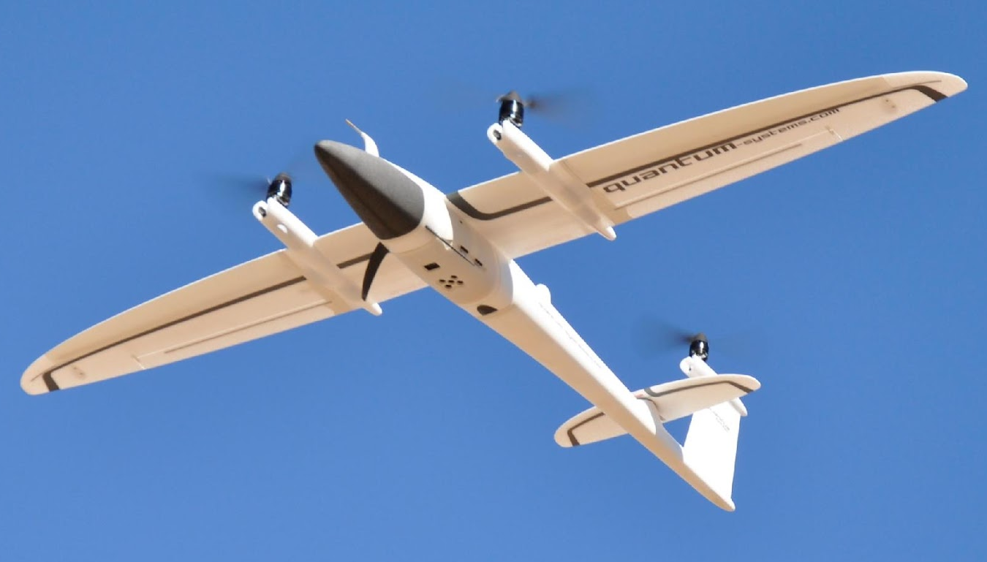
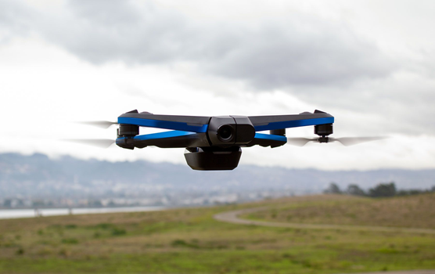
Systems: UAS Platforms Equipment
Trinity F90+
Skydio 2
UAS | Platform Type | Sensor | Utility | Data Type | Data Format | Flight Time | Wind Tolerance | Range
Skydio 2 | Quadcopter | Sony IMX577 | Video storm damage; determine path extent; access remote areas | 4K Video, Stills | mp4 | 23 min | 11.2 m/s | 3.5 km
Quantum Trinity F90+ | Fixed-wing (VTOL) | Sony UMC-R10C Micasense RedEdgeMX | Map storm damage (visible, multispectral) | Orthos, Point Clouds, DSM | Tiff, las, jpg | 90 min | 12 m/s | 7.5 km
Notes:
**Show what different sensors-resolutions give you

Slide 4
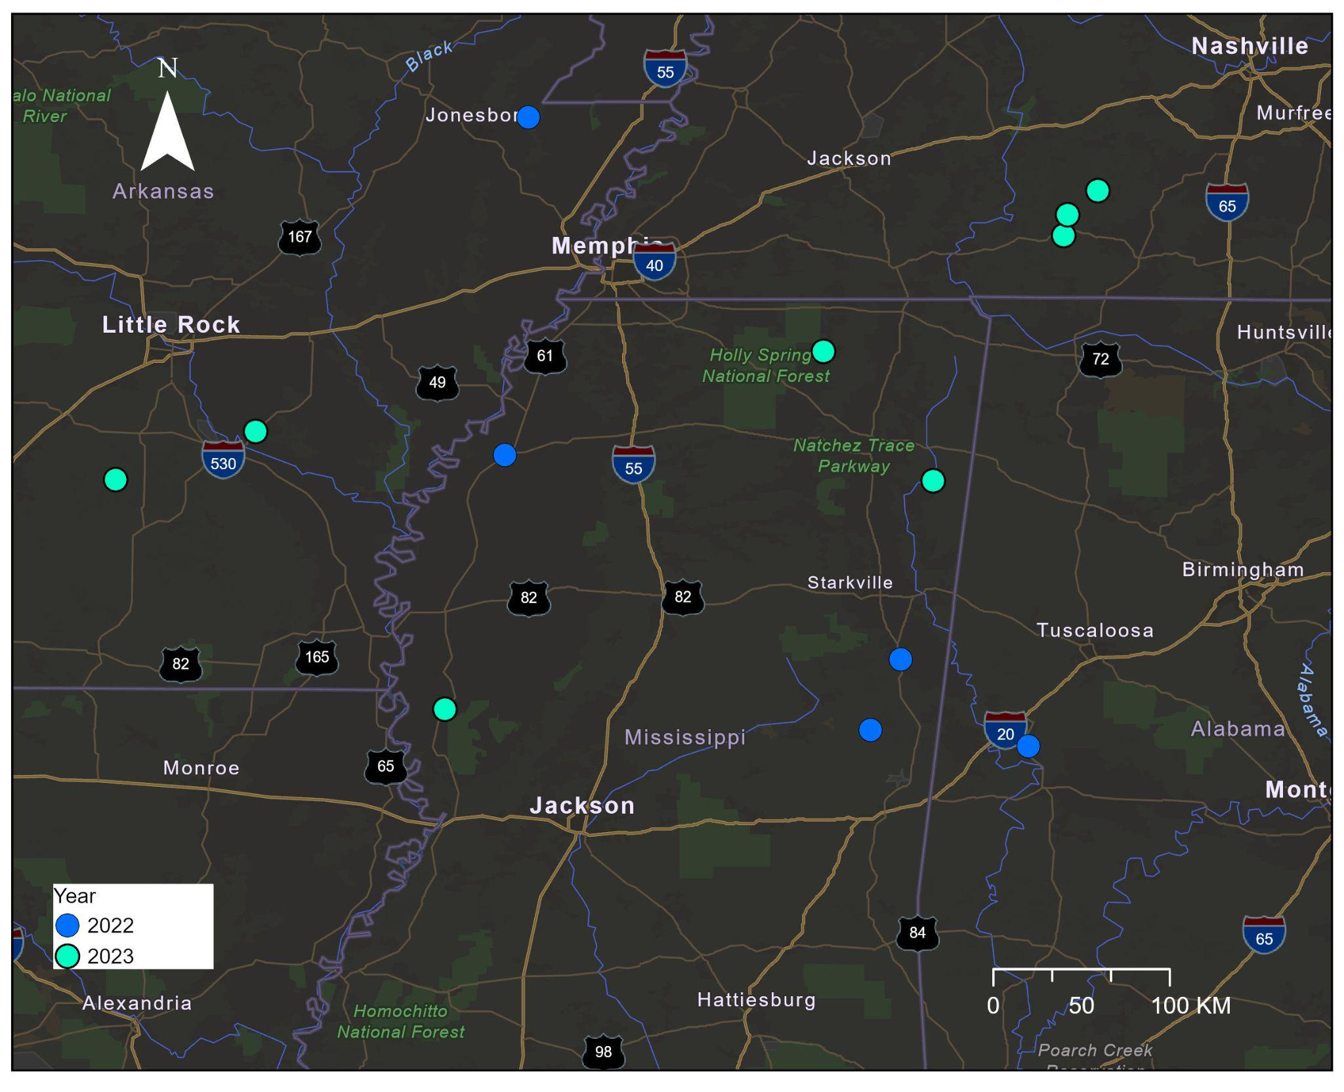
UAS Damage Surveys

Slide 5
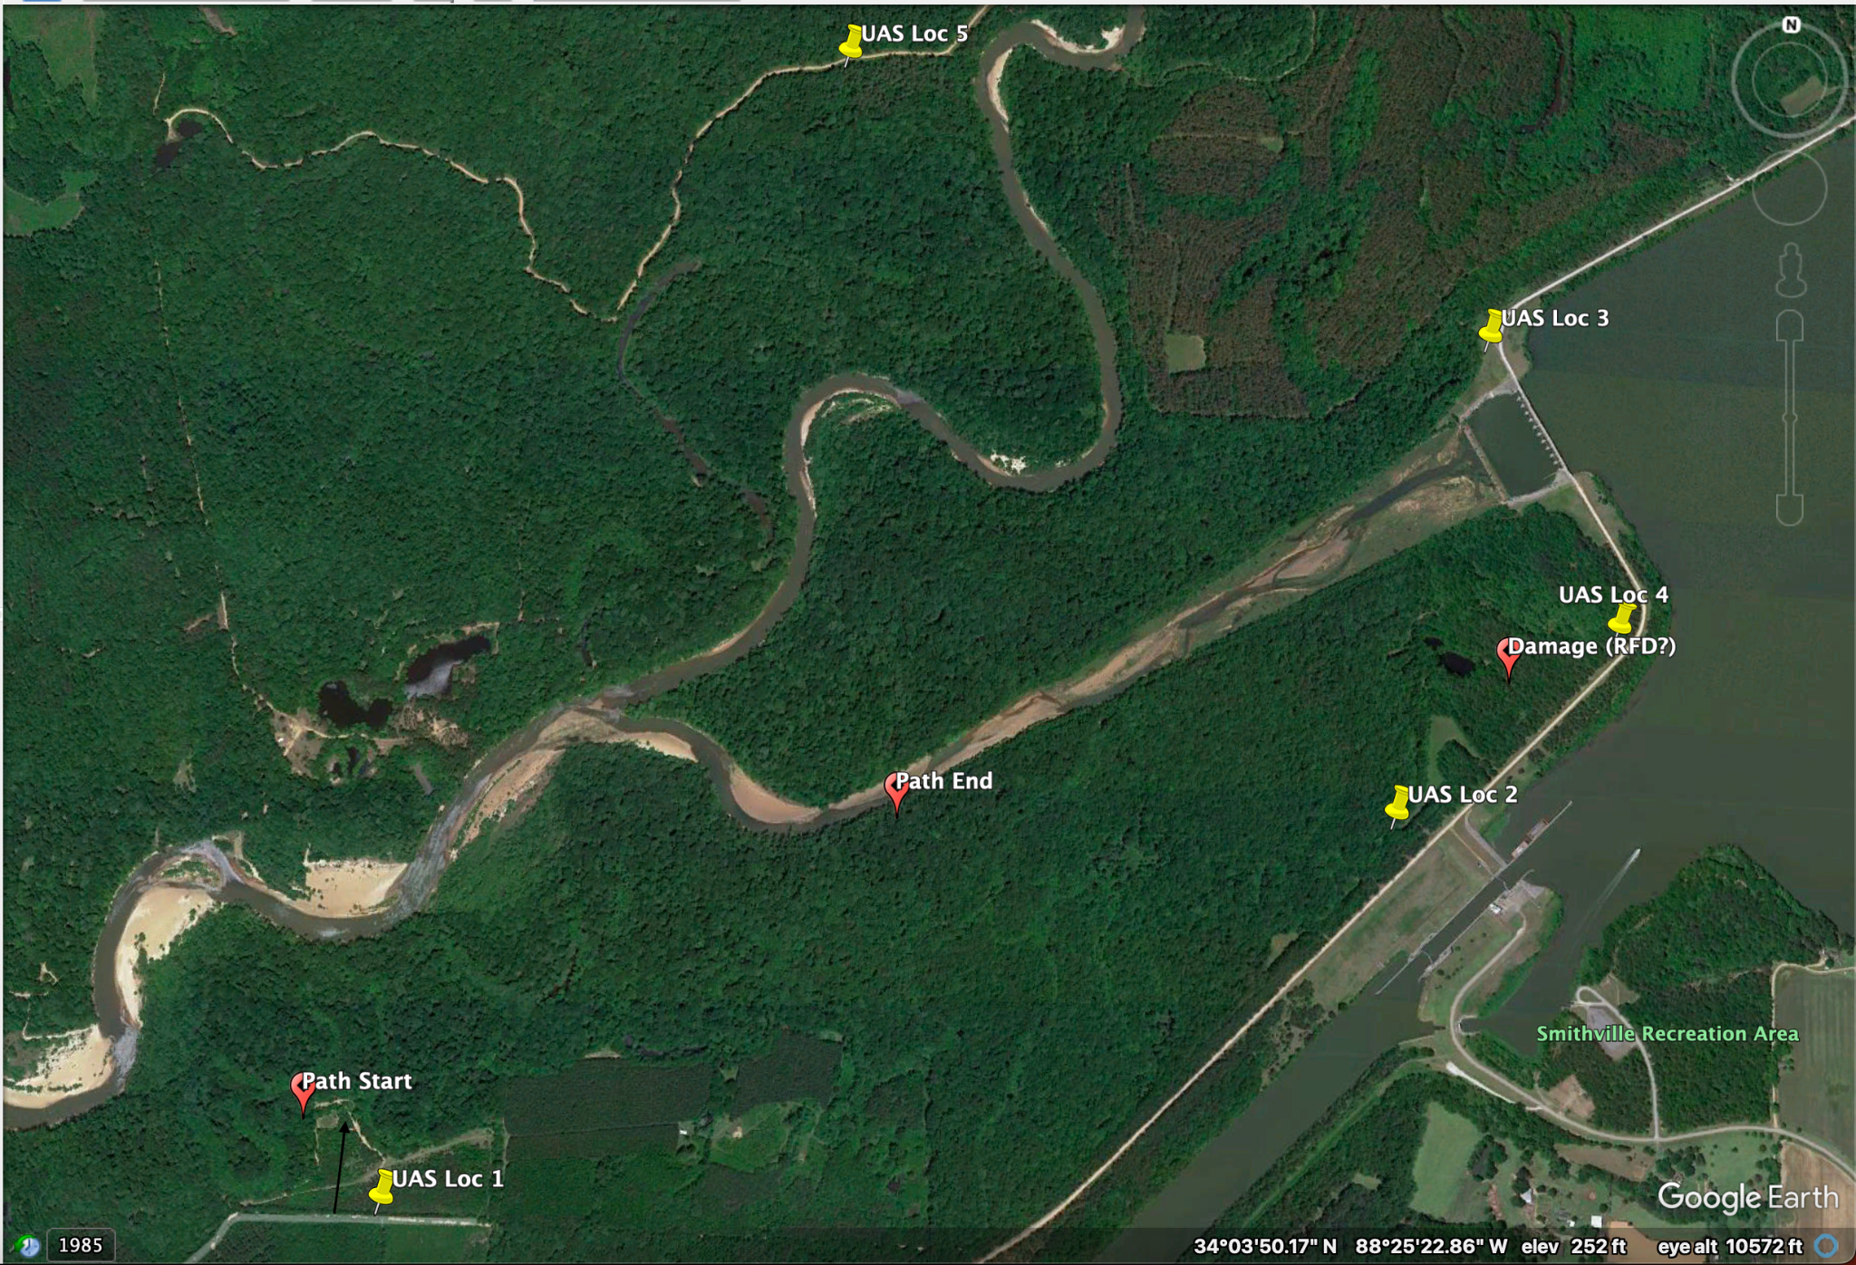
PERiLS 2023 IOP 1 - Smithville MS (& Ripley, MS)
UAS Videos (No Mapping) Skysat Imagery
Skysat Imagery

Slide 6
PERiLS 2023 IOP 2 - Altheimer and Carthage AR
Data: UAS videos (Skydio 4K resolution), UAS Mapping, satellite (Skysat) imagery
Locations: Carthage, AR; Atheimer, AR
Land Cover Characteristics: Forest (logging/natural), trees (breaks), open fields (agricultural), rural structures
Notes:
Altheimer, AR: minimal damage observed mostly in tree breaks. Mapped one section (multispectral data).
Carthage, AR: tree damage (breaks and falls) observed in logged/forested area (satellite imagery and UAS videos)

Slide 7
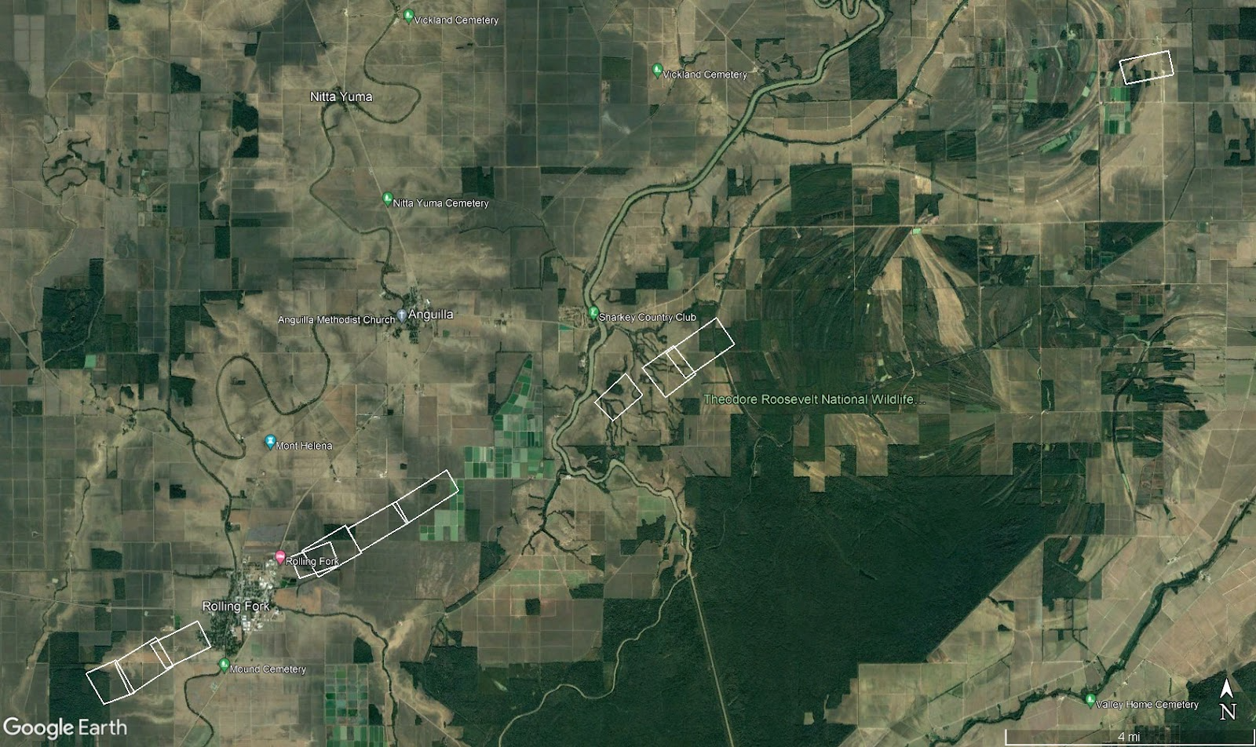
PERiLS IOP 3 Rolling Fork, MS
Focused on open fields
‘Ground Scours’
Land Cover transitions
Skysat Imagery
UAS mapping
UAS mapping
UAS mapping

Slide 8
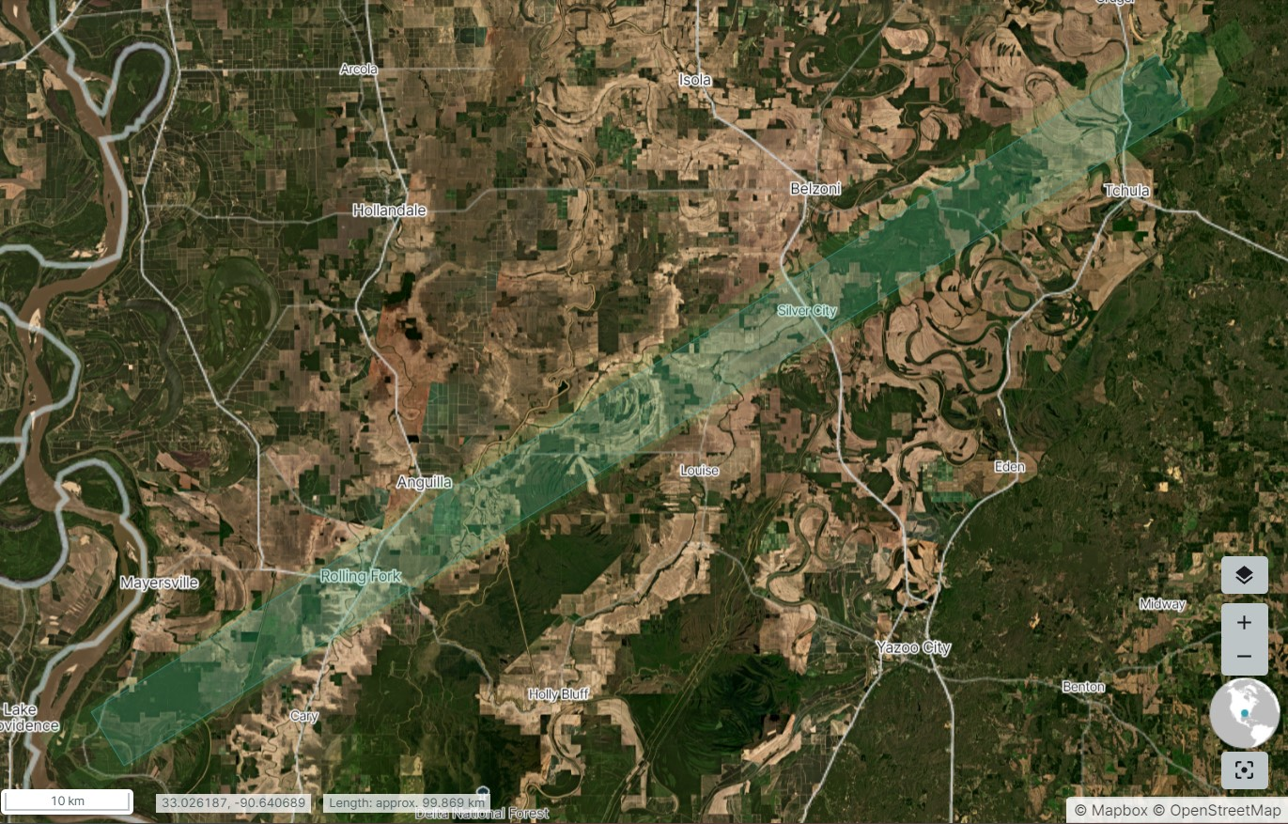
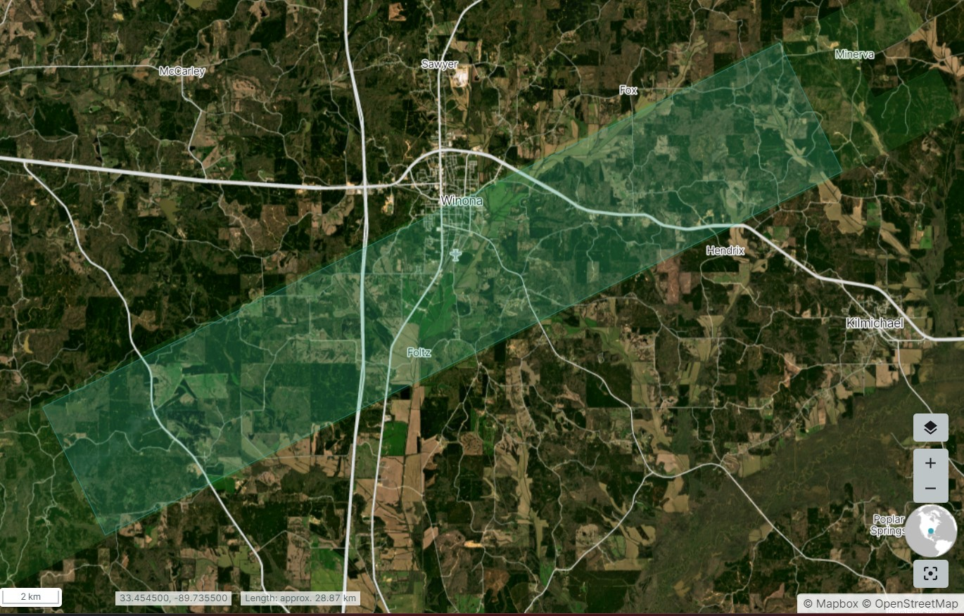
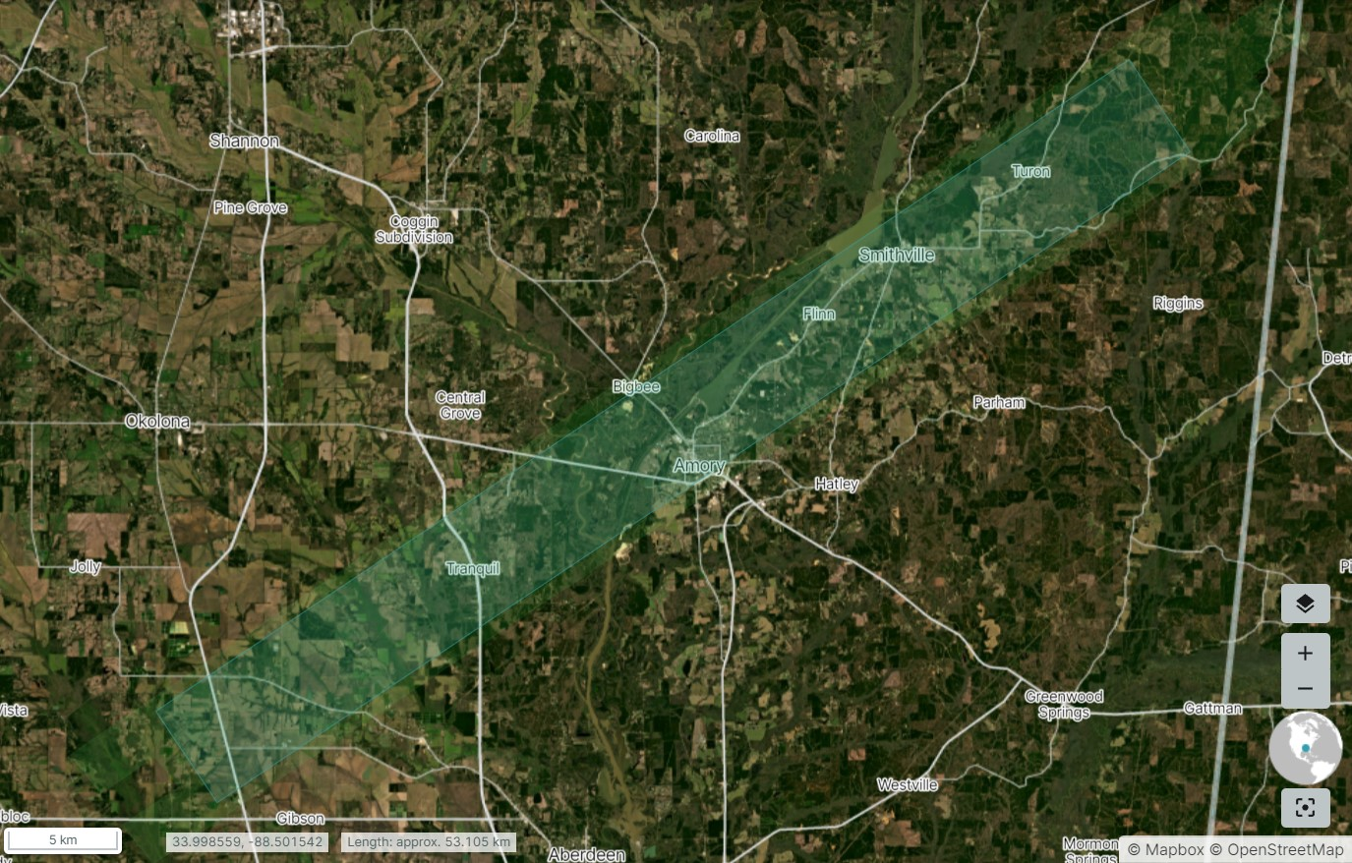
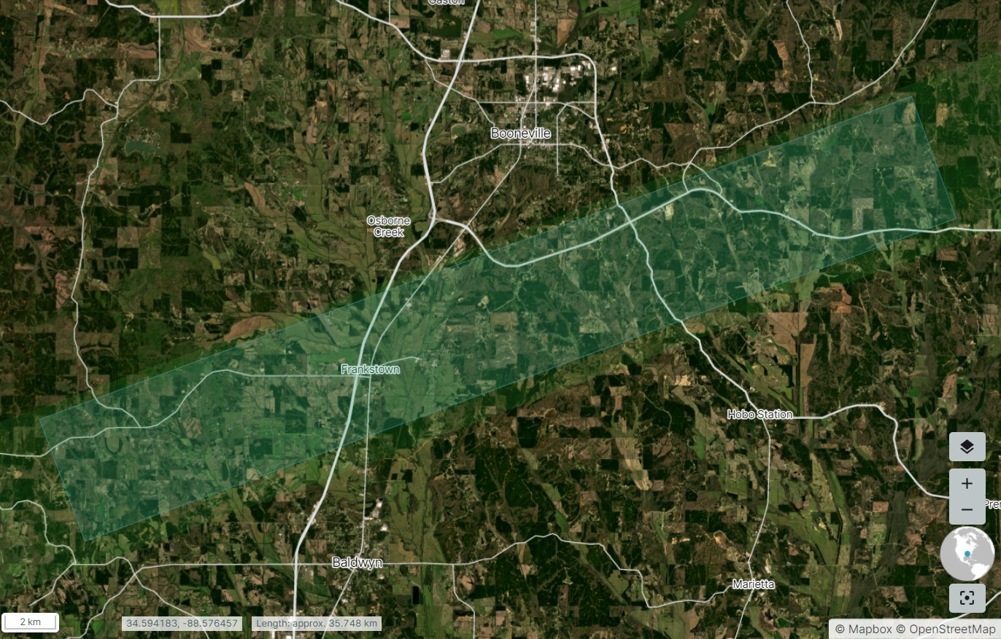
Skysat Imagery
Winona, MS
PERiLS IOP 3
Rolling Fork, MS
Amory, MS
Wheeler MS

Slide 9
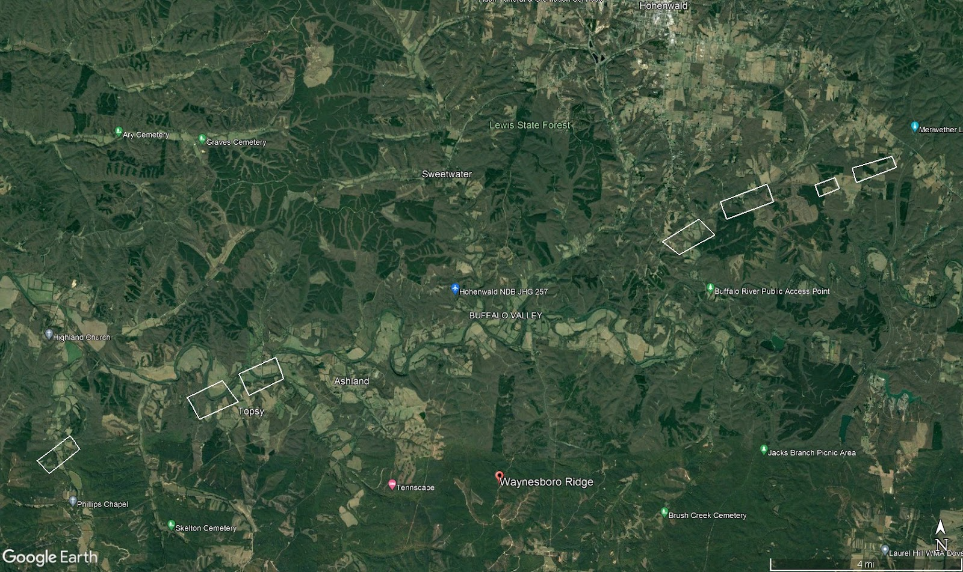
PERiLS IOP 4 Waynesboro-Hohenwald, TN
UAS mapping
UAS mapping

Slide 10
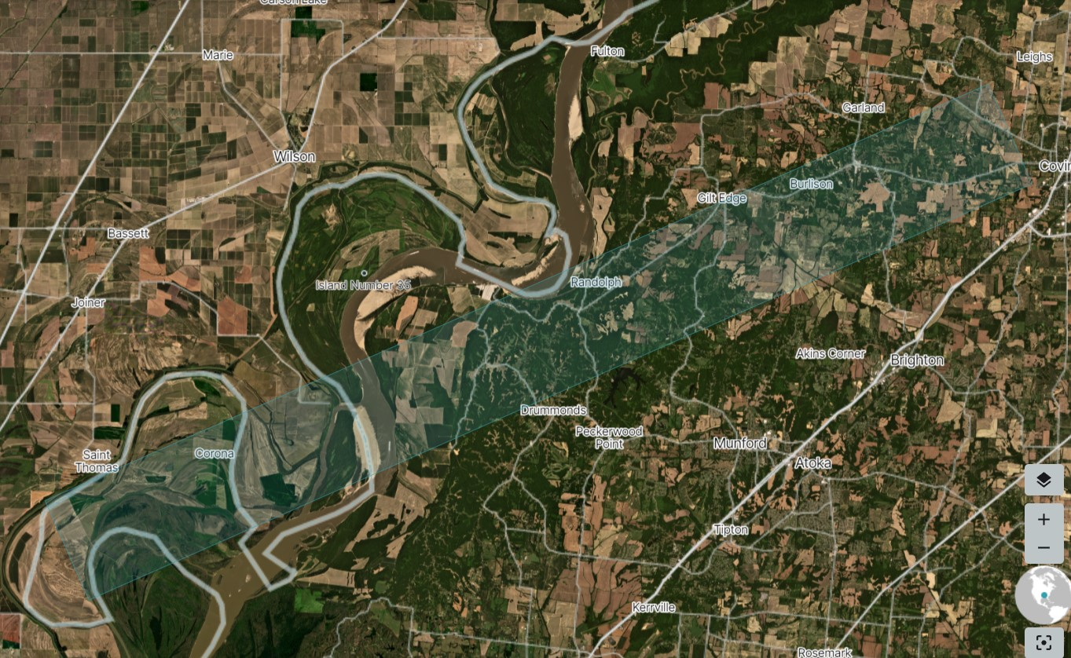
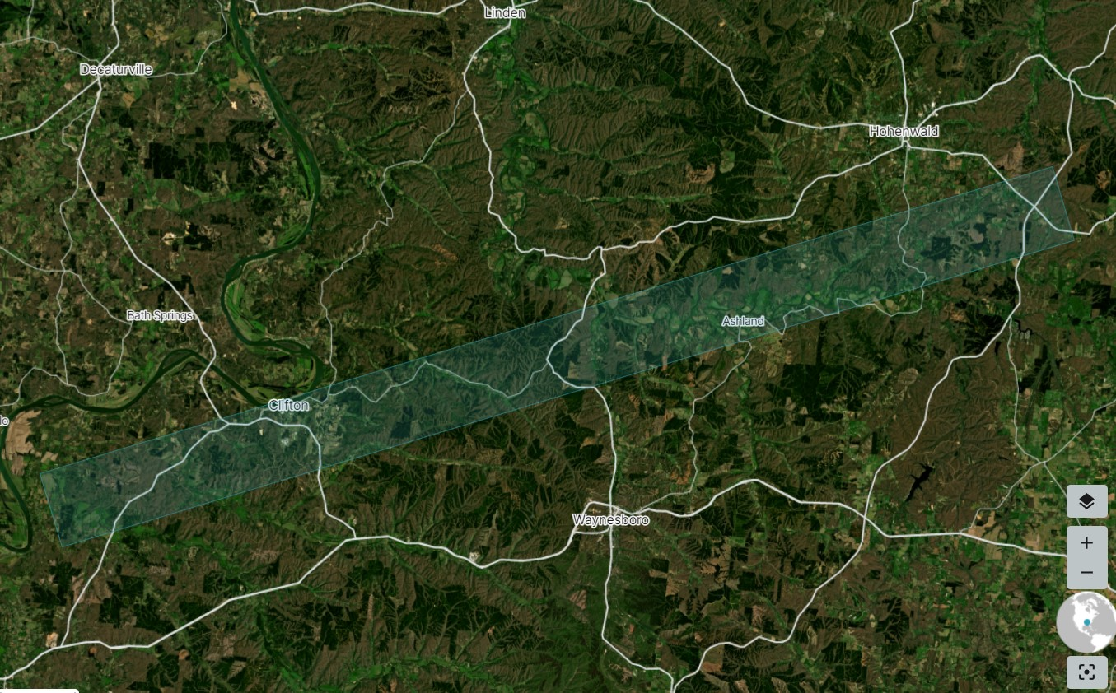
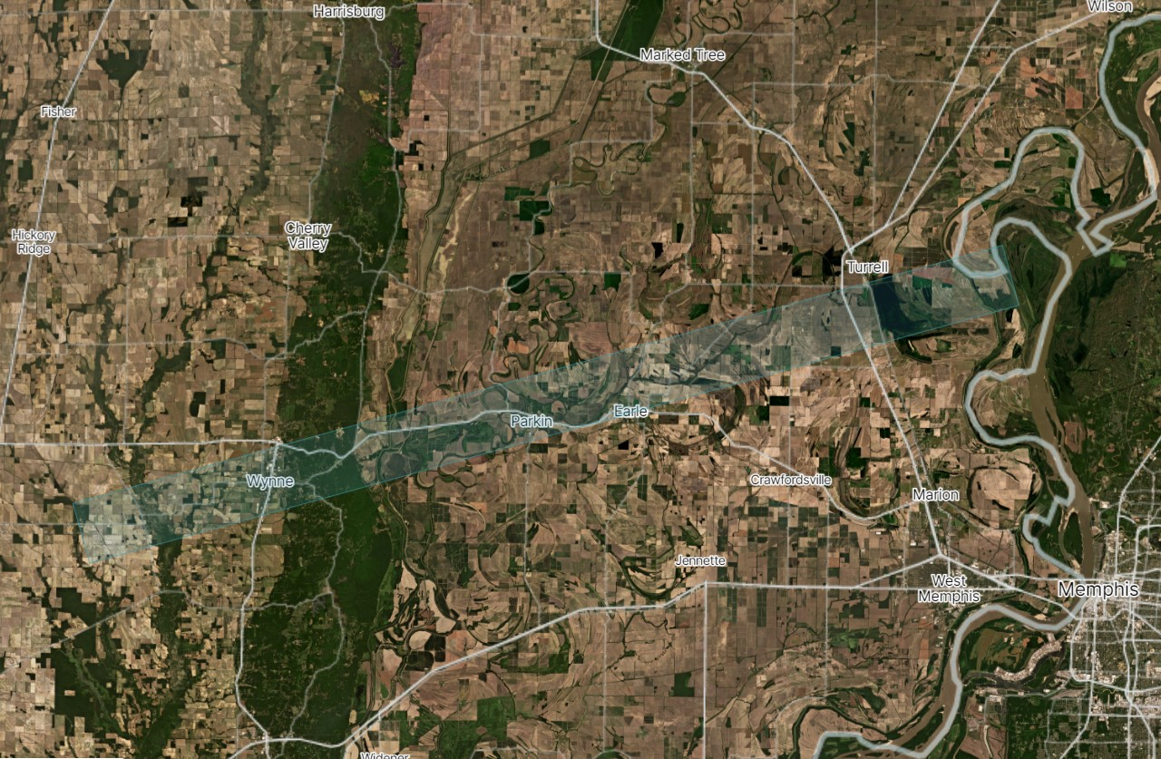
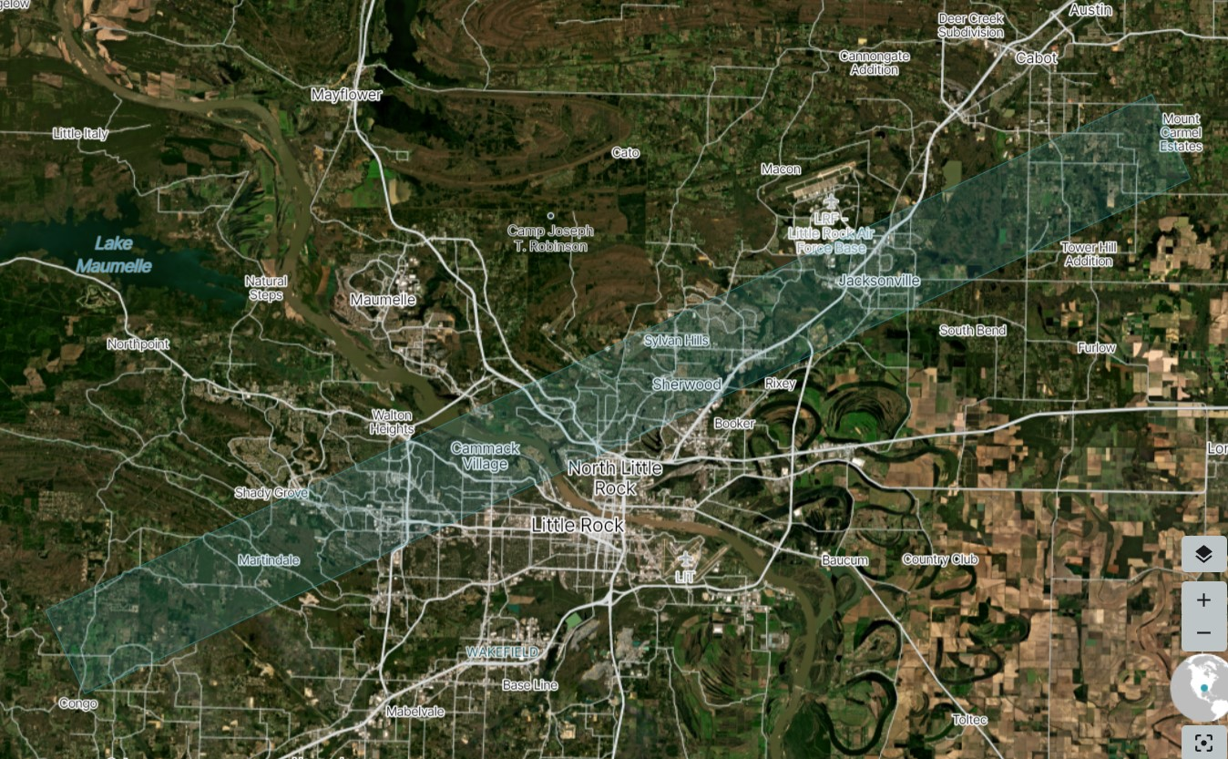
Skysat Imagery
Waynesboro-Hohenwald, TN
PERiLS IOP 4
Drummond, TN
Wynne, AR
Little Rock, AR

Slide 11
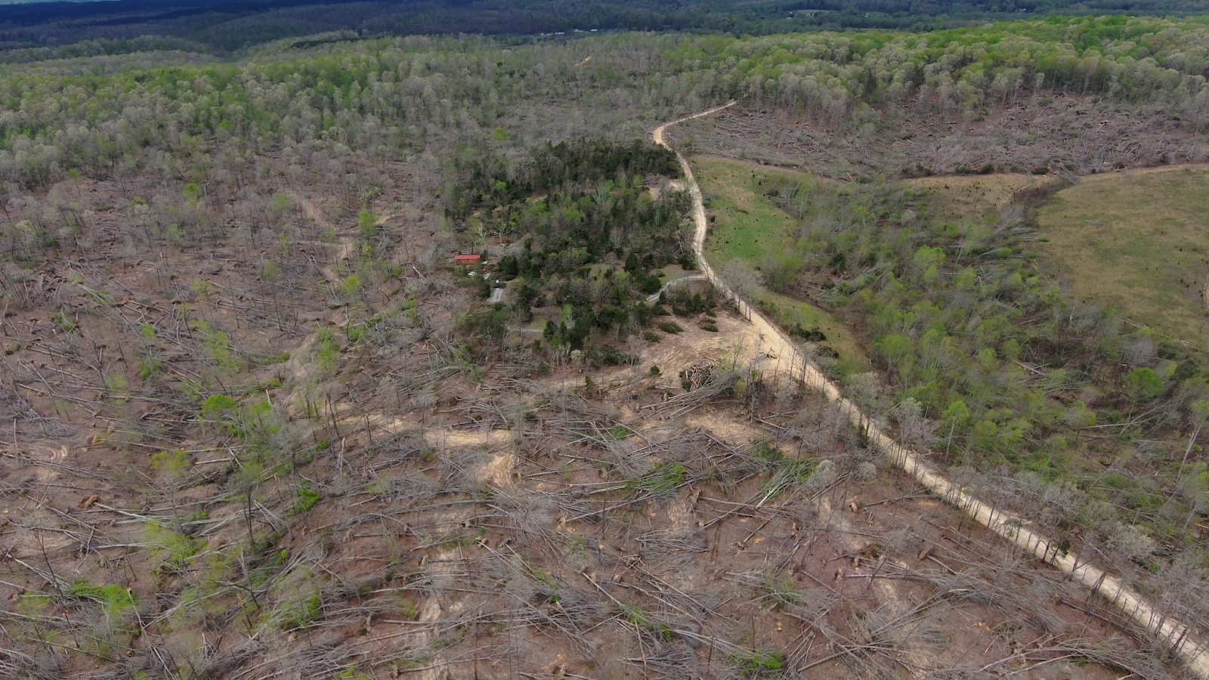
Data Availability
Data processed - Quality Control
Exploring best methods for archival & sharing per NOAA data policies (large datasets)
Contact: melissa.a.wagner@noaa.gov
Higgins Hollow TN - PERiLS IOP 4

