Slide 1
A survey of PERiLS cold pools
Miranda Silcott* and Matt Parker
Marine, Earth, & Atmospheric Sciences
North Carolina State University
Raleigh, North Carolina
*current affiliation: CIWRO/NSSL, Norman, OK
with collaborators:
Karen Kosiba, Steve Nesbitt, Jeff Trapp, Chris Weiss, Josh Wurman
Acknowledgments: NSF grant AGS-2020588; B. Coffer; G. Lackmann; S. Yuter; numerous students and technicians who worked on our teams in the field

Slide 2
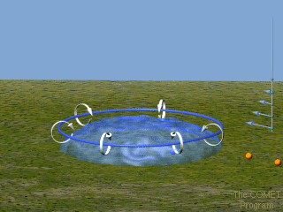
MOTIVATION
Cold pool properties are important for a number of squall line processes
Lifting that facilitates system maintenance
Baroclinic generation of horizontal vorticity that might be linked to vortices
COMET: MCS module

Slide 3
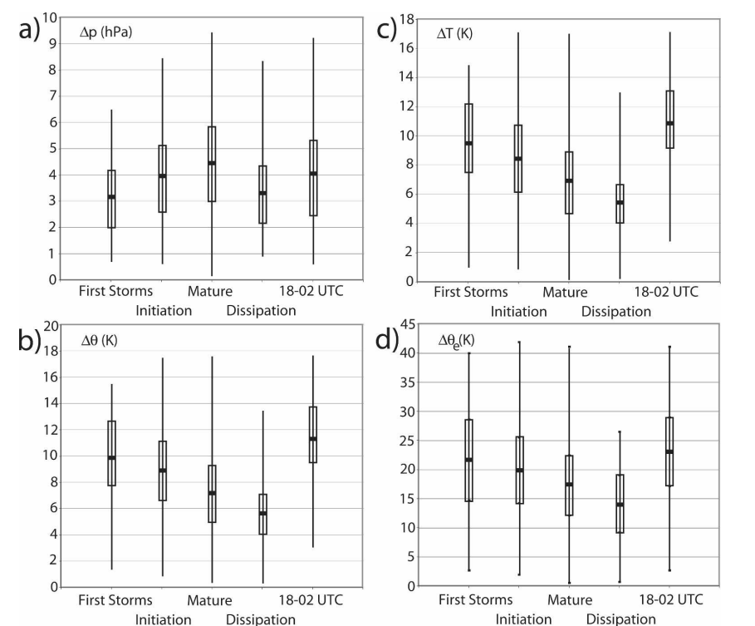
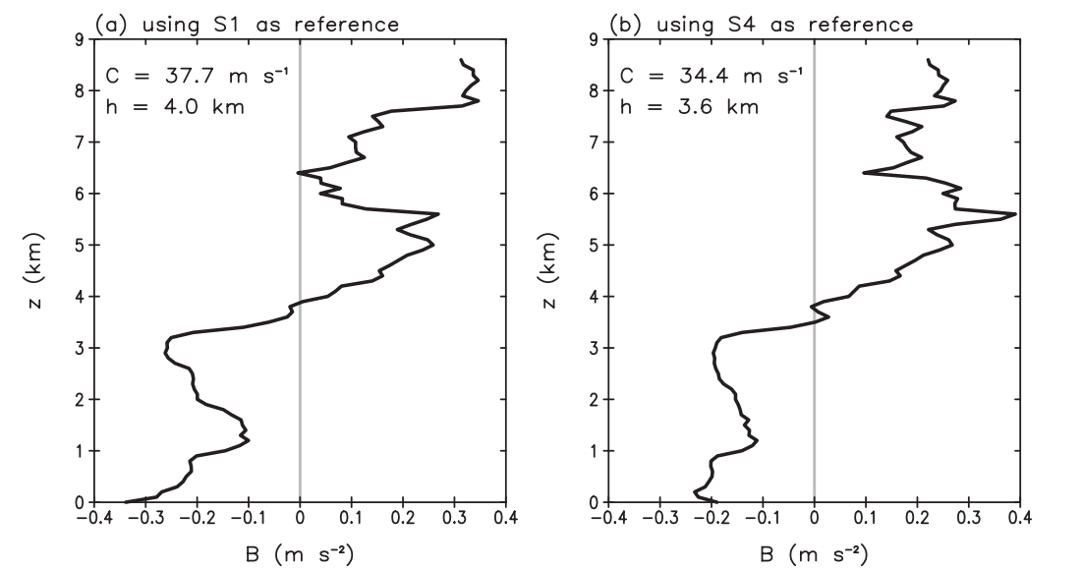
BACKGROUND
Engerer et al (2008):
surface observations of 39 Oklahoma QLCSs
Bryan and Parker (2010):
series of soundings from one Oklahoma QLCS
“Perhaps a cold pool ‘audit’ would be beneficial to the community.” –Bryan and Parker (2010)
We’ve had only a few glimpses at cool season/Southeastern QLCS cold pools
(e.g. McDonald and Weiss 2021)

Slide 4
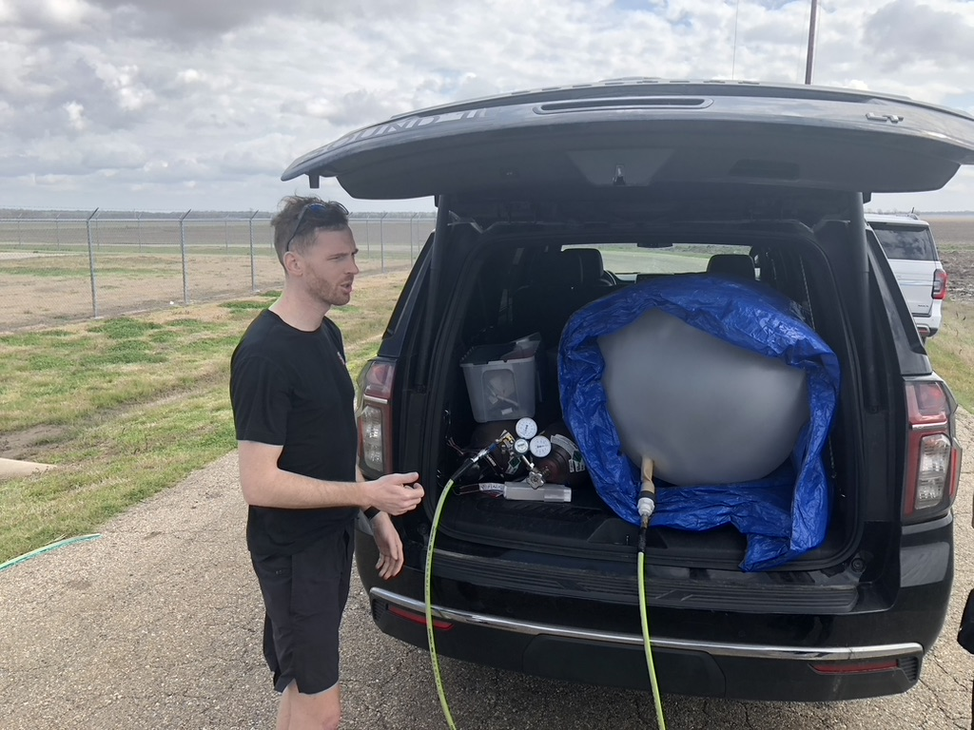
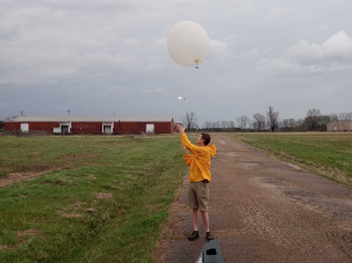
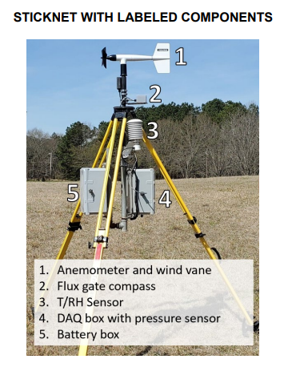
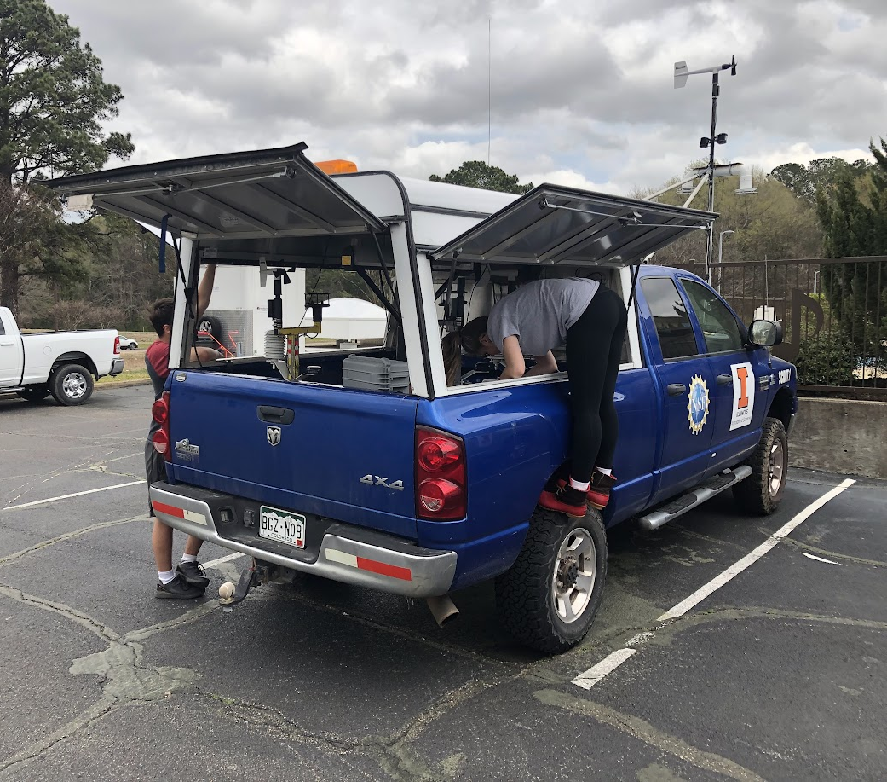
CORE DATASETS (SO FAR)
5 NCSU/UIUC/FARM Sounding Systems
2-3 NCSU/UIUC/FARM Mobile Mesonets + FARM Pods
TTU Sticknets (“Stesonet”)
Y1 full QC, Y2 pre-QC

Slide 5
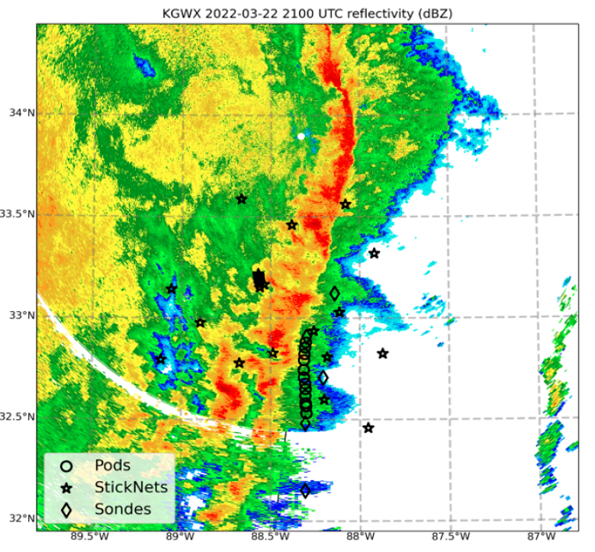
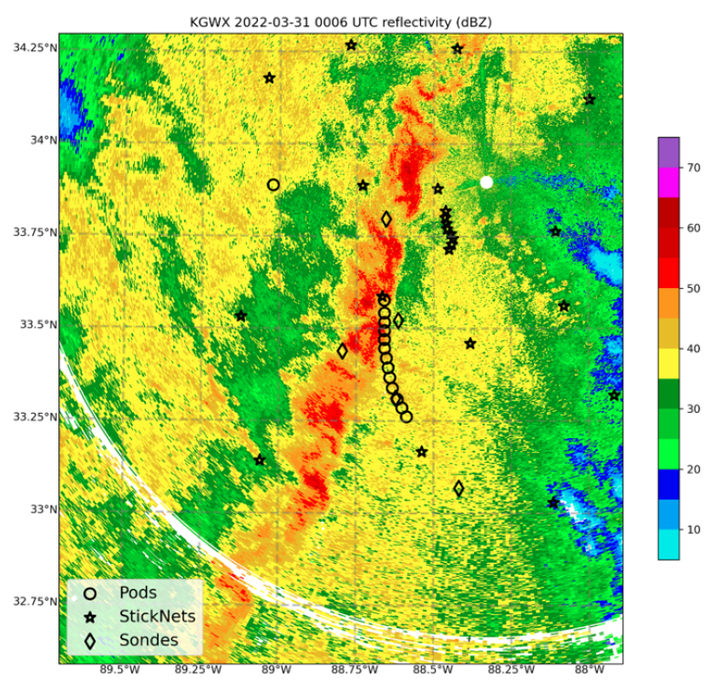
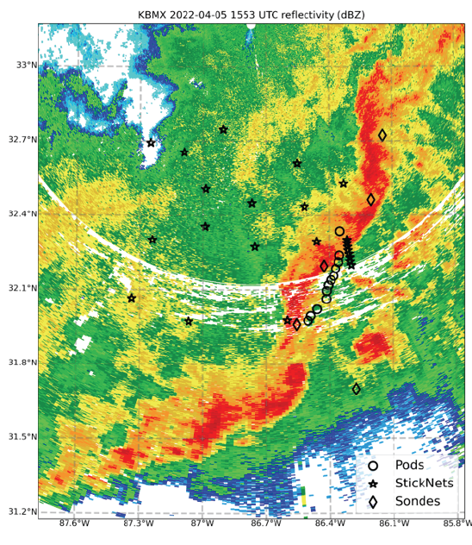
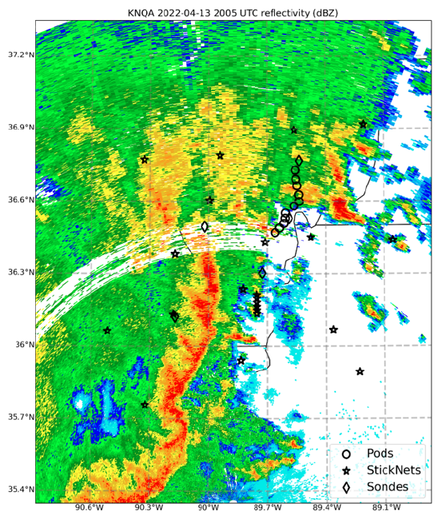
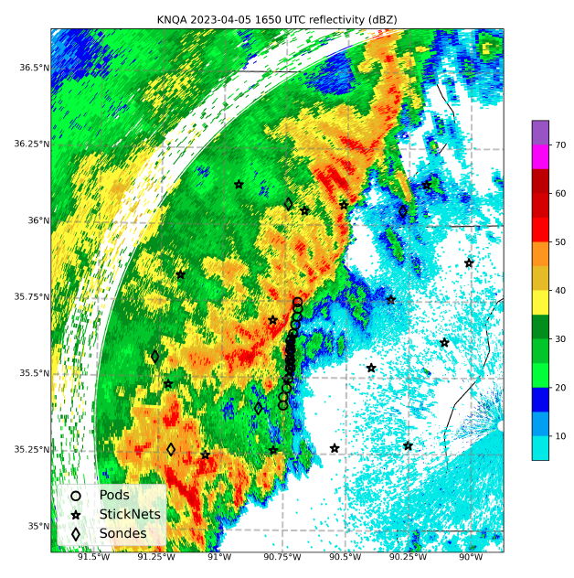
CASE SELECTION
Y1 IOP1
Y1 IOP2
Y1 IOP3
broken line (supercells) filling in
classic HSLC QLCS
heavy pre-QLCS precip
Y1 IOP4
Y2 IOP5 (pre-QC)
broken line
(near miss
for soundings
and pods)
highest CAPE
in PERiLS

Slide 6
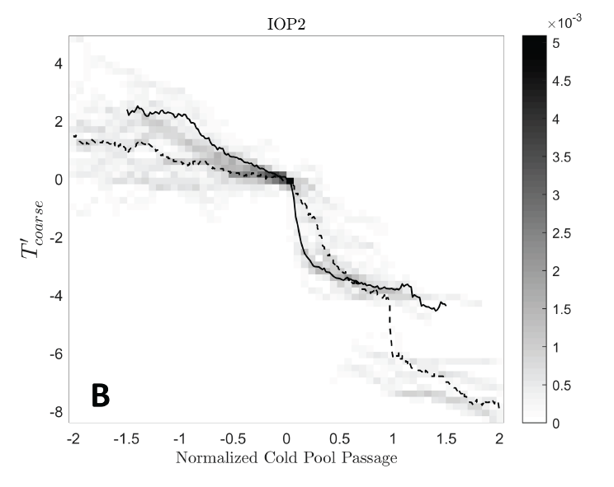
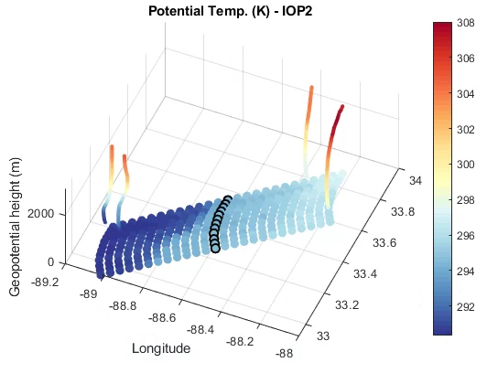
SAMPLE DEPLOYMENT AND DATA
Median and distribution of T’ for IOP2
Y1 IOP2
sfc temperature perturbation (K)
pods
Sticknets
pod array
time (hours) relative to gust front passage
$θ$ (K)
cold pool depth
soundings
gust front
pod array
time-to-space conversions of individual time series

Slide 7
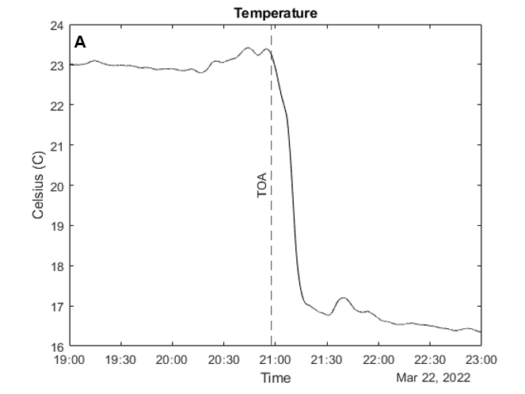
SURFACE-DERIVED PRODUCTS
In surface observations, cold pools are characterized via changes (∆) across the gust front
1 - hour
T_{max}
∆T = T_{max} - T_{min}
T_{min}
1 - hour
∆T – Temperature
∆T_{d} – Dewpoint
∆p – Pressure
∆V_{perp} – Line-perpendicular surface wind (not the RKW thing)
∆θ_{e} - Equivalent Potential Temperature

Slide 8
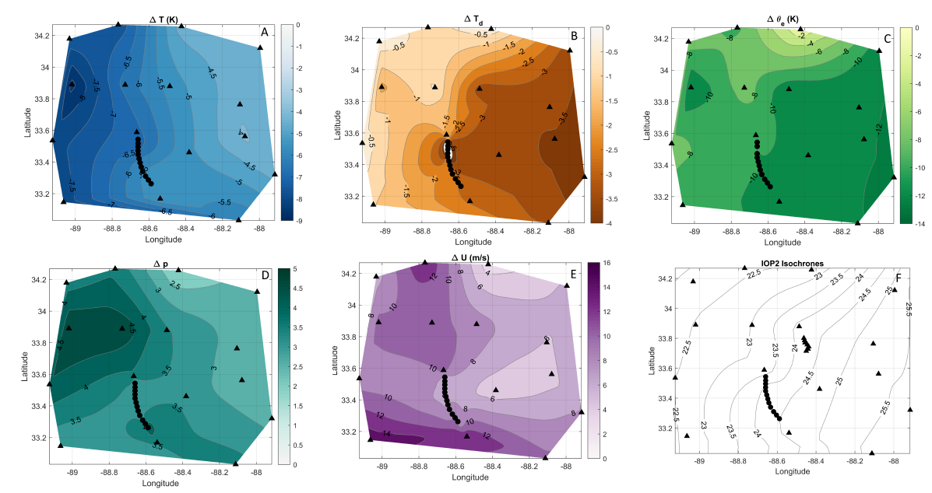
SURFACE-DERIVED PRODUCTS
As the cold pool crosses the surface array, we can characterize each ∆ field
at each instrument to capture spatial/temporal trends
∆T_{d} (K)
∆p (hPa)
∆V_{perp} (m/s)

Slide 9
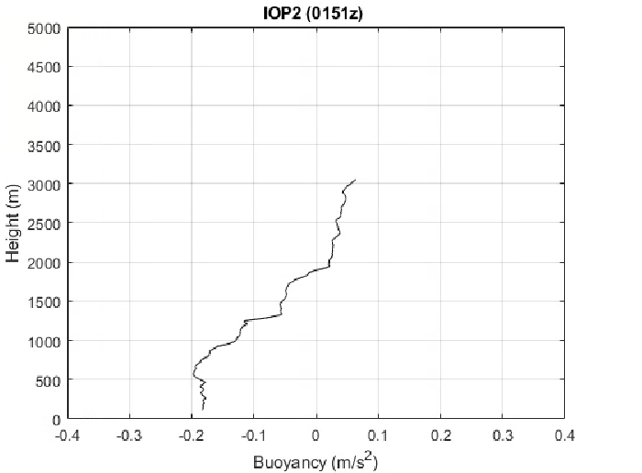
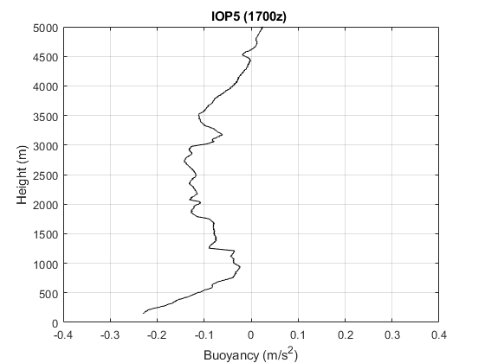
SOUNDING-DERIVED PRODUCTS
We compute a mean base state from soundings < 1 hour before gust front arrival
and derive depth (“h”) and intensity (“C”)
via the relative buoyancy profiles of soundings within the cold pool
Representative PERiLS cold pool profile (Y1 IOP2)
Strongest PERiLS cold pool profile (Y2 IOP5)
h = 1890 m
C = 21.0 m/s
h = 4370 m
C = 27.7 m/s
${\text{C}}^{\text{2}} \text{=} \text{−2}\int_{\text{sfc}}^{\text{h}}{\text{B} \text{dz}}$

Slide 10
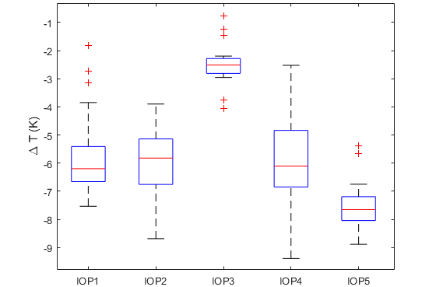
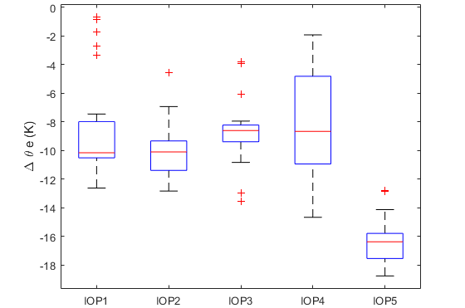
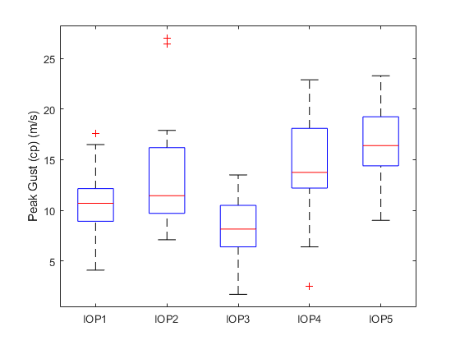
CASE-BY-CASE: SURFACE PARAMETERS
Box and whisker plots of distributions
∆T (K)
∆θ_{e} (K)
V_{max} (m s⁻¹)
Generally: Consistency from case to case
IOP3: Nearly-saturated environment:
almost no cooling!

Slide 11
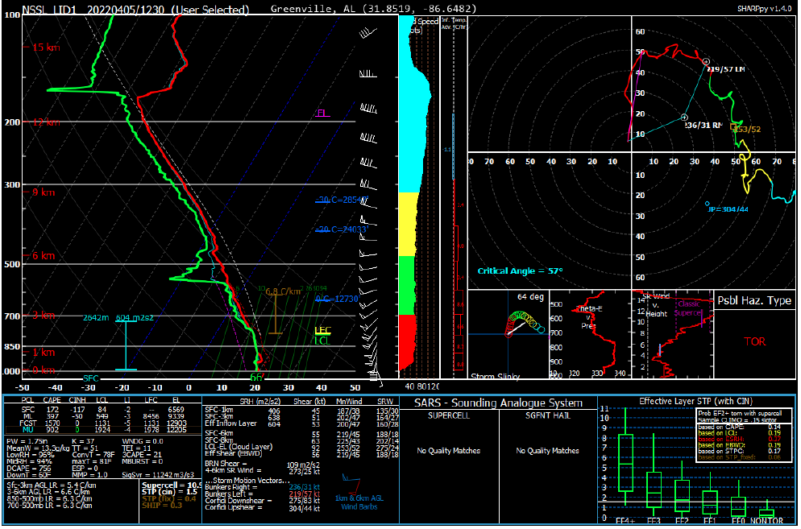
CASE-BY-CASE: SURFACE PARAMETERS
Box and whisker plots of distributions
∆T (K)
∆θ_{e} (K)
V_{max} (m s⁻¹)
Generally: Consistency from case to case
IOP3: Nearly-saturated environment:
almost no cooling!

Slide 12
CASE-BY-CASE: SURFACE PARAMETERS
Box and whisker plots of distributions
∆T (K)
∆θ_{e} (K)
V_{max} (m s⁻¹)
Generally: Consistency from case to case
IOP3: Nearly-saturated environment:
almost no cooling!
Y2 IOP5: Coldest outflows, very low θ_{e} :
highest CAPE, driest mid-levels

Slide 13
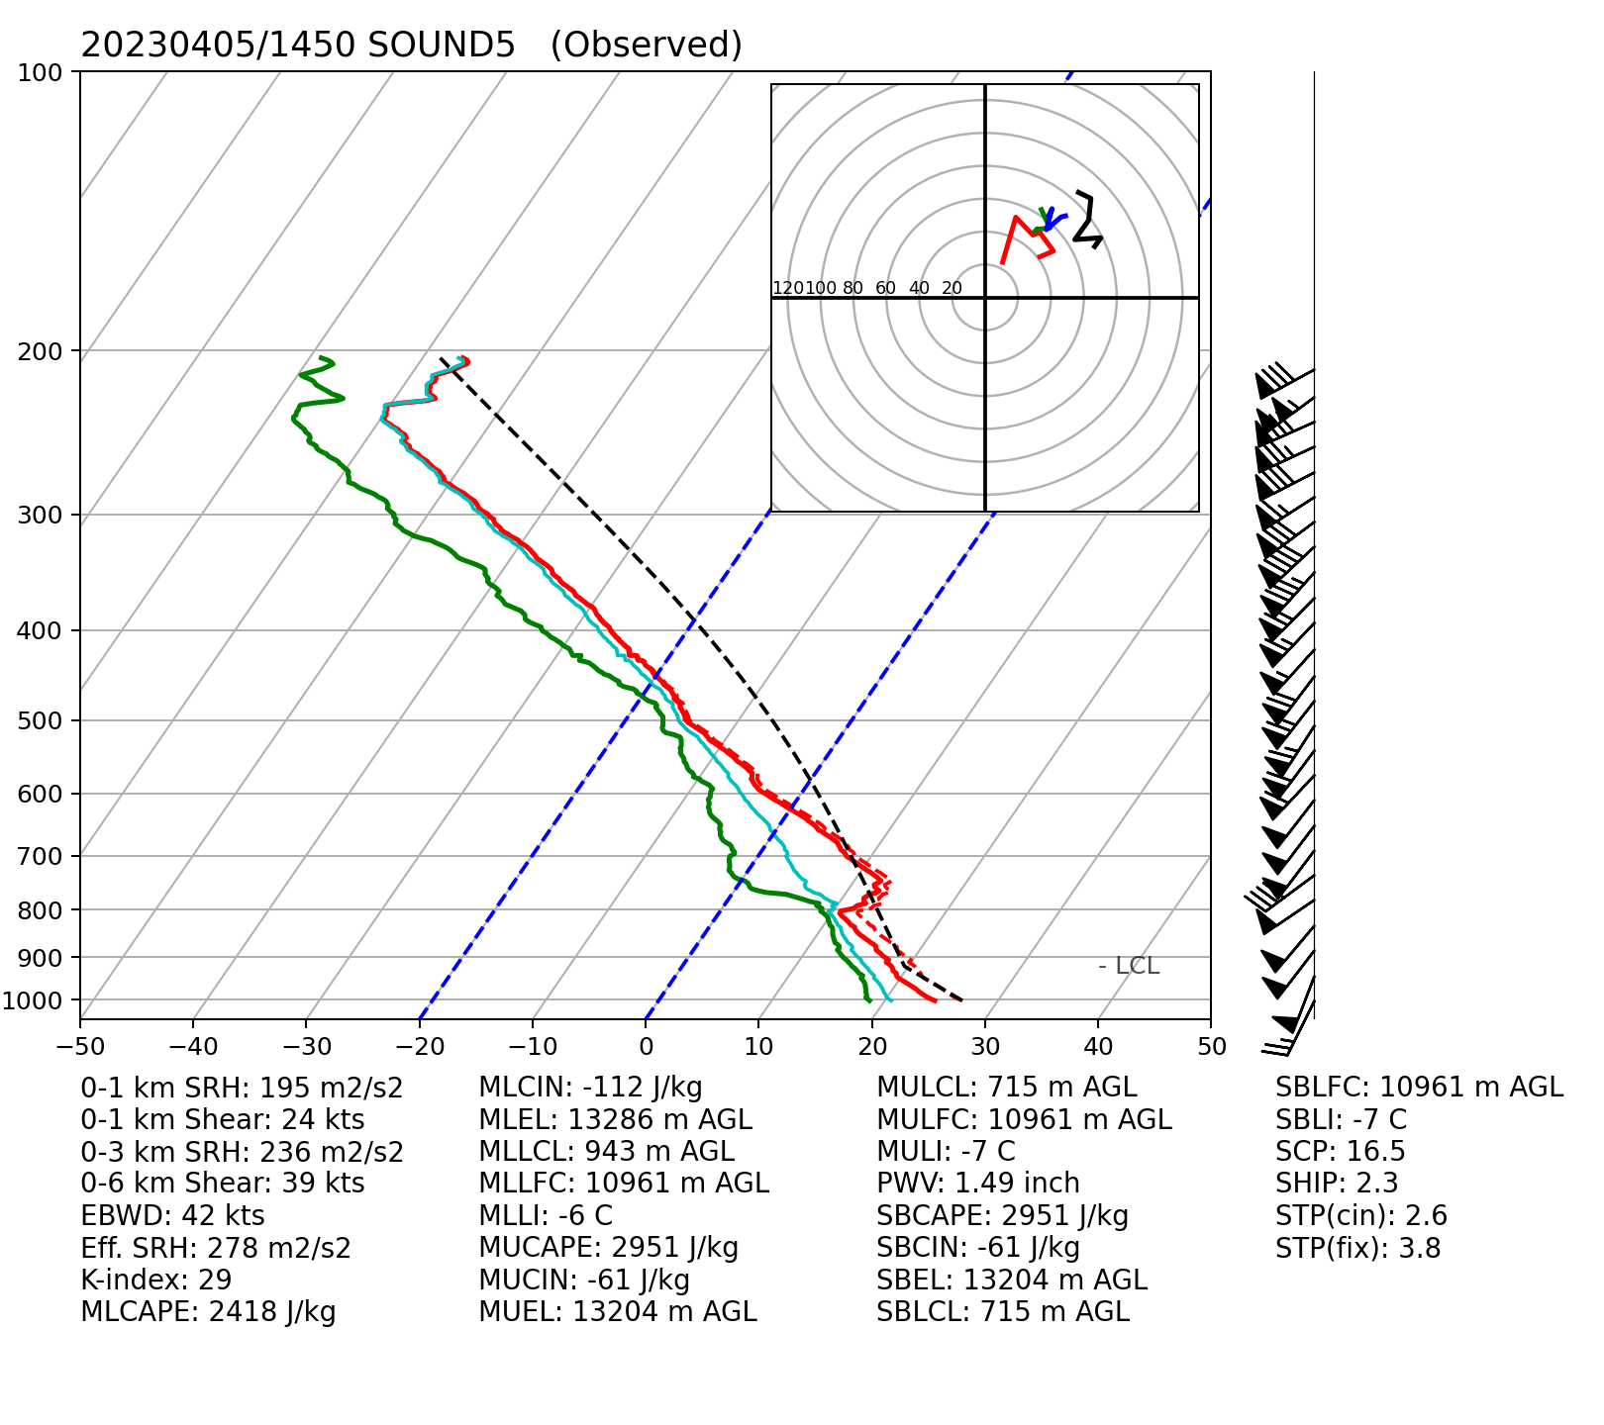
CASE-BY-CASE: SURFACE PARAMETERS
Box and whisker plots of distributions
∆T (K)
∆θ_{e} (K)
V_{max} (m s⁻¹)
Generally: Consistency from case to case
IOP3: Nearly-saturated environment:
almost no cooling!
Y2 IOP5: Coldest outflows, very low θ_{e} :
highest CAPE, driest mid-levels

Slide 14
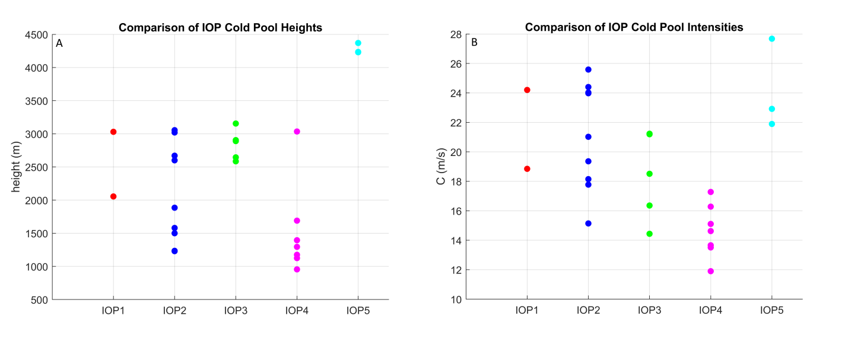
CASE-BY-CASE: SOUNDING PARAMETERS
${\text{C}}^{\text{2}} \text{=} \text{−2}\int_{\text{sfc}}^{\text{h}}{\text{B} \text{dz}}$
IOPs 1-2: Perhaps the cases that “typify” Southeastern HSLC cold pools?
IOP3: Nearly-saturated environment: cold pools deep but weak
IOP4: Probably under-sampled (broken line); a singular deep cold pool ob
Y2 IOP5: Most “Plains-like” cold pools (deepest and coldest: high CAPE, dry mid-levels)

Slide 15
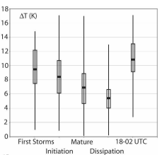
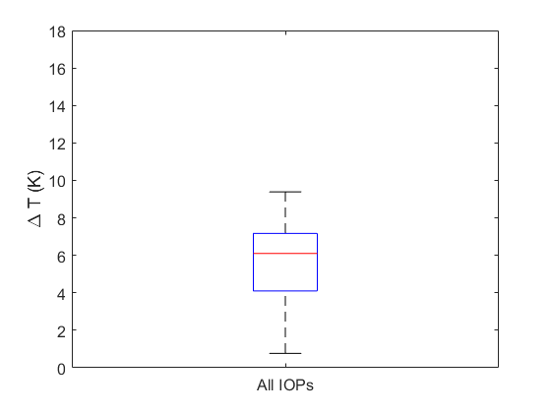
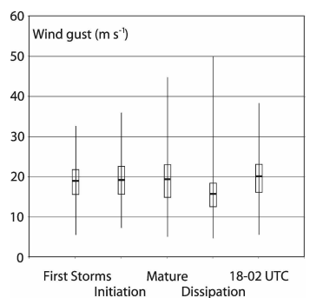
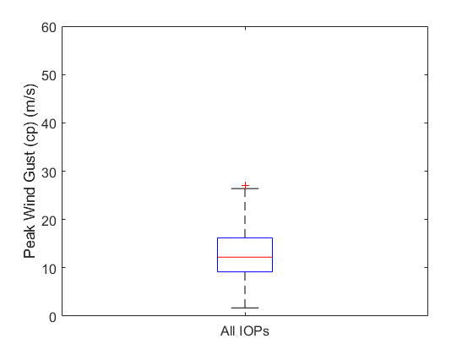
PERiLS VS. PLAINS: SURFACE PARAMETERSS
Box and whisker plots
of distributions
Great Plains values from Engerer et al (2008)
PERiLS surface observations
across 5 cases
cold pool
temperature
deficits
cold pool
peak wind gusts
There is some overlap in terms of typical temperature deficits in PERiLS and Great Plains cold pools.
But, extreme temperature deficits were comparatively rare in PERiLS.
And, peak outflow winds were generally weaker than those in the Plains.

Slide 16
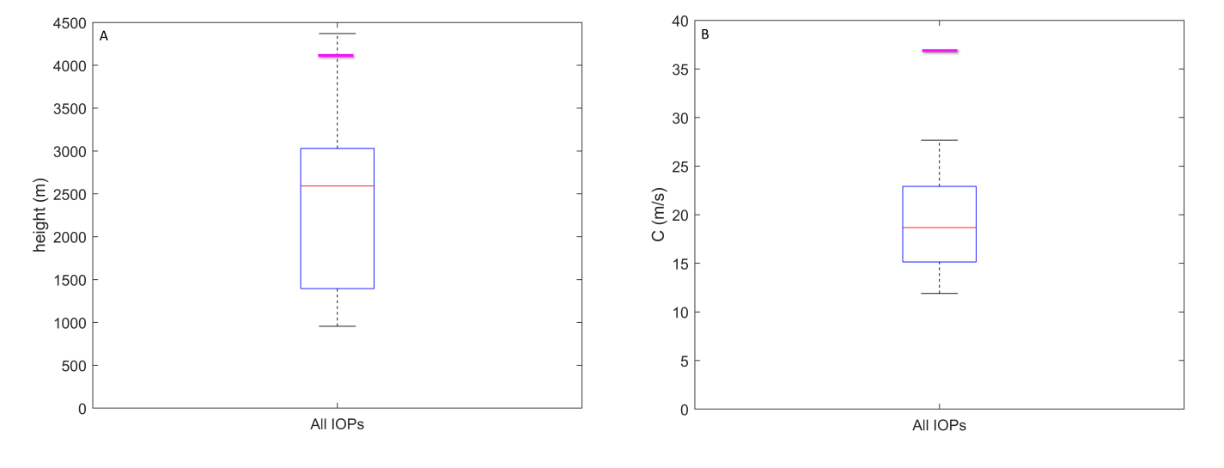
PERiLS VS. PLAINS: SOUNDING PARAMETERS
Box and whisker plots
of distributions
${\text{C}}^{\text{2}} \text{=} \text{−2}\int_{\text{sfc}}^{\text{h}}{\text{B} \text{dz}}$
PERiLS sounding observations across 5 cases vs.
Great Plains values from Bryan and Parker (2010)
depth of cold pools (m)
integrated intensity of cold pools (m/s)
Cold pools in PERiLS were almost always shallower and of lower integrated intensity (“C”) than Great Plains cold pools.

Slide 17
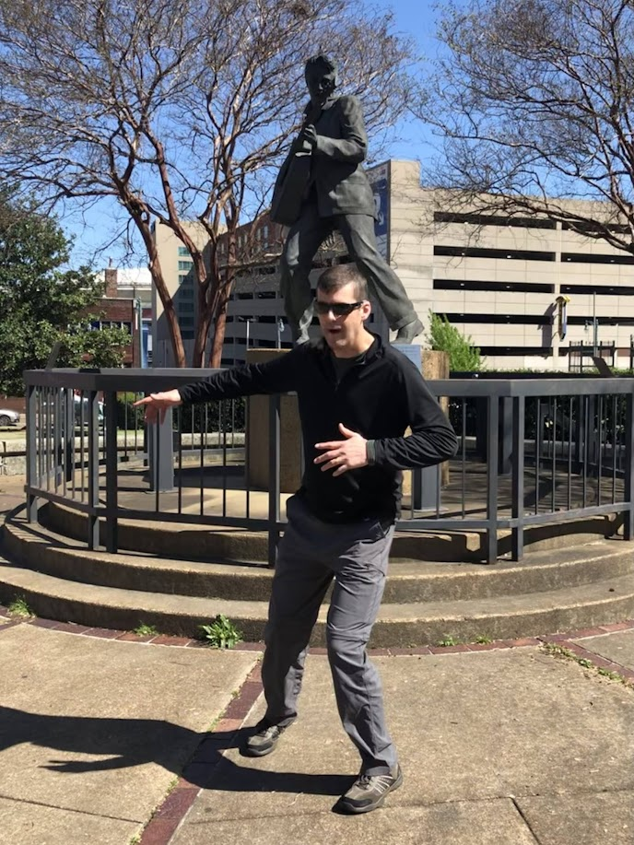
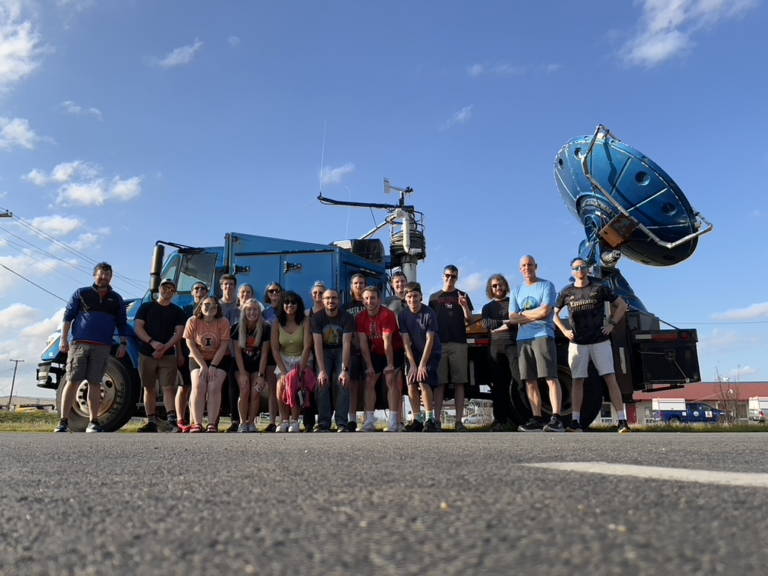
RECAP
All of the cold pools in PILSNER ELVIS PERiLS would be considered weaker than those studied in higher-CAPE midlatitude environments, typically being both less-cold and shallower than those studied by Engerer et al. (2008) and Bryan and Parker (2010).
Lower CAPE
Higher lower tropospheric RH
Y2 IOP5 serves as a partial counter-example
Nevertheless, these QLCSs generally:
Were long-lived
Produced severe winds
Exhibited mesovortices and often tornadoes
Perhaps even modest cold pools are sufficient for many QLCS
processes… what does C look like vs. environmental ∆U?
What is the large scale forcing doing? What other PERiLS
datasets could be brought to bear? The saga continues…

